Slide 1
Welcome to CST8218 Web Enterprise Applications
Professor Todd Kelley
Office: Zoom (T315)
E-mail: kelleyt@algonquincollege.com
Office Hours: send me an email

Slide 2
Agenda
Development environment
Course Overview
Logistics
Enterprise Applications
Java Enterprise Edition

Slide 3


Enterprise Programs
Programmer
1
Netbeans
IDE
6
Jakarta EE
Glassfish 5.1
war file for
deployment
3
2
mavenproject1/
Web Pages
Source Packages
…
…
5
6
Web Browser
4
6
User

Slide 4
Standard Environment
Creating Program
Programmer create classes, one with method main
public static void main(String args[]){…}
Compile classes into Java Bytecode
Optionally create *.jar archive containing the classes

Slide 5
Standard Environment (cont'd)
Running Program
User runs JVM with binary class that has main (or *.jar archive of all classes)
JVM calls that main method
main method runs in the JVM
main method creates new objects, calls more methods, and so on
Program is finished when main method (and its threads) finishes

Slide 6
Enterprise Edition
Creating Program
Programmer creates classes with annotations
Entities: @Entity
Named Beans: @Named
Enterprise Java Beans: @Stateless, @Stateful, etc
Annotations determine the purpose of the code and how the server will use it for the application
Compile the classes
Create a deployable application archive (*.war, *.jar, or *.ear) containing the binary classes and other info

Slide 7
Enterprise Edition (cont'd)
Deploying Program
Programmer or IT person arranges for a Jakarta EE (formerly Java EE) application server to be running on the server hardware
An application server is like a web server but application servers have more capabilities
Programmer or IT person deploys the application archive to the application server (Glassfish) and enables the application

Slide 8
Enterprise Edition (cont'd)
Running the Program
User launches their web browser (many users are possible at the same time)
User types in the URL of the application (which includes the server machine address, port, and the path to the application on that server)
Application server serves the page corresponding to the URL (starting point for the application)
User interacts with the application through the web browser

Slide 9
Enterprise Edition (cont'd)
Finishing the user session
Applications often have logout function
User closes their browser window
This does not affect other users currently interacting with the application
Terminating the program
Applications do not terminate as with SE
IT person or programmer can disable the application on the application server
Applications can be undeployed from the application server
Alternatively, shut down application server

Slide 10
Enterprise Web Applications
Server-side Java: Jakarta EE
Programming with Java, including annotations
Java EE technologies have moved to the Eclipse Foundation: Glassfish 5.1
Netbeans IDE
Netbeans has traditionally had good integration with Glassfish
Eclipse has modules to offer good integration too
Three Tiered Architecture (address-book)
Presentation Layer (JSF pages with their Named bean controller)
Business Layer (Enterprise Java Beans, business rules, façade for Data Layer)
Data Layer (Derby, MariaDB, MySQL, Oracle, Postgres, MS SQL Server, etc)
Persistence
Object Relational Mapping
Persistence Unit, persistence.xml specifies
the set of Entities
the database connection
RESTful HTTP interface (REST API)
Can be used for
Mobile App backend server
B2B (Business to Business)
M2M (Machine to Machine)
Presentation Layer
JSF Java Server Faces
Validators, Converters, Localization
React Page
Securing with Authentication/Authorization
Declarative security
Testing
Junit
Selenium

Slide 11
Logistics
Hybrid Course Format
Each week there will be
Two hours of lecture (like this one)
roughly one hour of online hybrid activities
watch video, do online tutorial, blackboard quizzes, etc
two hours of lab time
mixture of exercises and assignments
team project

Slide 12
Evaluation
Hybrid Activities/Quizzes 5%
Assignments 35%
Lab Activities 5% (+10%)
Lab Demonstrations 10% (5x2%)
Midterm Test 15%
Final Examination 30%

Slide 13
Labs and Assignments
See the Submission Requirements in Lab and Assignments folders on Brightspace
You will demonstrate your work, as well as submit it before the deadline
Missing or skipping the demonstration incurs a large penalty, up to 100% of the entire assignment mark
Late assignments incur a penalty, up to 100% of the entire assignment mark

Slide 14
Tips for Success
Assignments are large bodies of work that cannot reasonably be completed in one or two sessions, even long sessions
Get started early
Get clarification and help early
Make good use of Lab Periods

Slide 15
Tips for Success (cont'd)
Rule One: 15 minute rule
if you are frustrated and not making progress for 15 minutes, you need to
take a break, move on to another part of the assignment, switch to other course work, come back to it later
sleep on it
seek help from a peer
seek help from the instructor

Slide 16
Tips for Success (cont'd)
Rule Two: Don't leave it to the last few days before the due date
Rule One is not feasible without Rule Two
Get started early, read through and understand the focus of the assignment and the tasks, as soon as you can
Keep up with the course pace (every week, you're expected to put in about 5 hours of time in addition to 5 hours of Hybrid Activities, Lectures, and Labs)

Slide 17
Excessive Help
Beware of receiving excessive help
Getting the right amount of help when it’s needed is important
It’s just as important to not get too much help
Do it yourself: reading documentation, figuring out how to apply what you read, and solving apparent inconsistencies/problems

Slide 18
Don’t take shortcuts in Labs
Like excessive help, shortcuts are bad
Suppose you are training for a marathon
your coach wants you to run a five kilometer training route
You feel overloaded and find a shortcut on the route to reduce it to one kilometer
You saved so much time doing it your way!
The short cut took so much less time and effort: where’s the problem?

Slide 19
Plagiarism
Cheating is unacceptable
Exchange ideas, but not code or text: don't plagiarize
The person you copy from is in just as much trouble as you
Adherence to acceptable standards of academic honesty is an important aspect of the learning process at Algonquin College. Academic work submitted by a student is evaluated on the assumption that the work presented by the student is his or her own, unless designated otherwise. For further details consult Algonquin College Policies AA18(http://www2.algonquincollege.com/directives/files/2011/01/AA-18-Academic- Dishonesty-and-Discipline.PEC_.Approved.-Oct.27.2010.pdf) and E43 (http://www2.algonquincollege.com/directives/files/2011/05/E431.pdf)

Slide 20
Netbeans IDE Integration
Edit code (Java, xhtml, XML)
Compile code and creates archives for deployment (*.war files)
Run a project (application)
Starts Glassfish Server if necessary
Starts Derby database server if necessary
Deploy *.war file to Glassfish
Enable/run application on Glassfish server
Launch web browser pointing at app’s URL
Display Glassfish Server output log
Access Glassfish Server administration webapp
Access Derby Database tables directly

Slide 21
Netbeans Tips
When programmer makes a mistake, runtime errors will show up in Glassfish server output
Your application runs on the server with glassfish, but Netbeans has a convenient tab to show you the Glassfish server log (Glassfish Output)
If the message is "see server log for details" you need to read the Glassfish Output

Slide 22
Netbeans Tips (cont'd)
Complex arrangement of technologies: there are bugs
In case of obscure errors/stack traces in Glassfish output, try clearing Netbeans cache, by quiting Netbeans and deleting
C:\Users\Name\appdata\local\Netbeans\cache\*

Slide 23
Netbeans Tips (cont’d)
Sometimes, a “clean+build” will fail because it cannot remove an old build file
Simply repeating the “clean+build” will often work
If repeating doesn’t work, restarting Netbeans (and thereby restarting Glassfish) should always address problems removing build files
Working with projects on networked drives (OneDrive, etc) may work, but it has also been known to cause problems with Netbeans

Slide 24
Enterprise Applications
What is an Enterprise Application?
Microsoft Excel?
Microsoft Outlook?
Google?
Facebook?
Gmail?

Slide 25
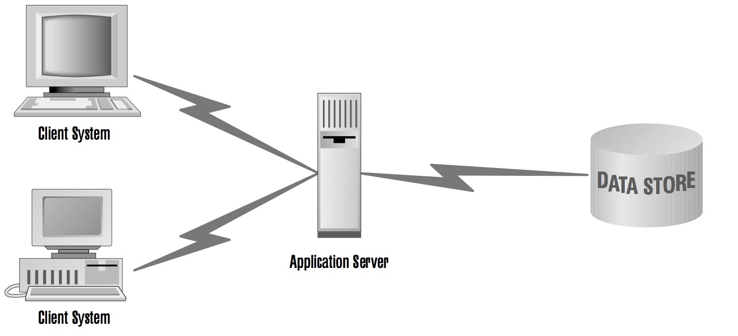
Enterprise Architecture

Slide 26
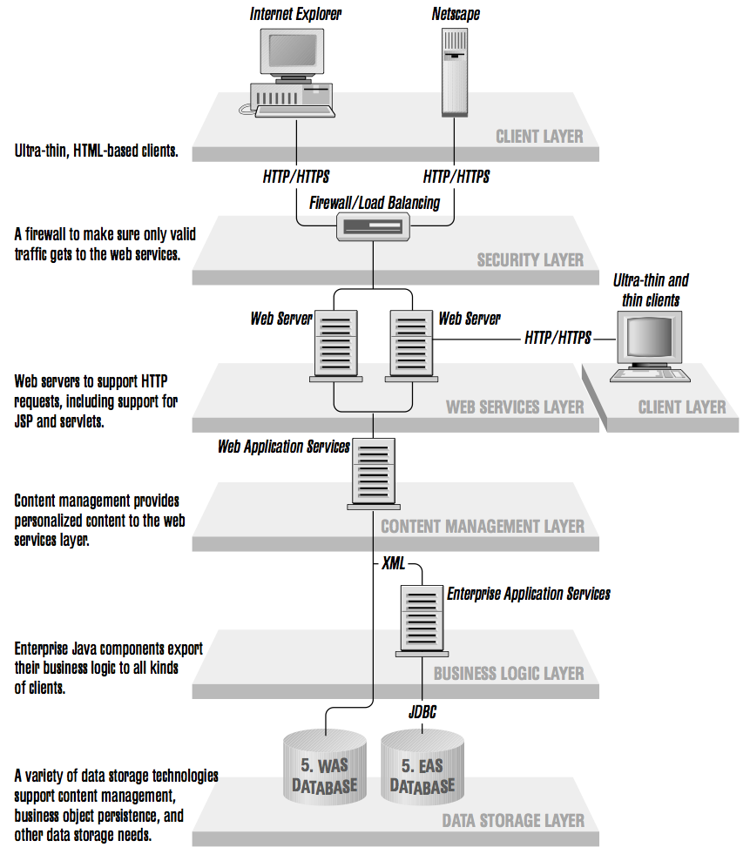
Enterprise Architecture

Slide 27
Enterprise Applications
Many simultaneous users
Multithreading
Ten thousand simultaneous users won't be in the same place
Networking
Remote Method Invocation (RMI)
Deal with Persistent Data
Databases
Concurrent Database Access
Object Relational Mapping (ORM)

Slide 28
What is Jakarta EE? (formerly Java EE)
A large list of documents:
JSRs (Java Specification Requests) – technical documents that describe a Java technology Java EE 8 – JSR-366 is the overall architecture doc, refers to another about 40 individual JSRs
Complete list - https://www.oracle.com/technetwork/java/javaee/tech/java-ee-8-3890673.html
Glassfish is the Reference Implementation – a working implementation of the specs; clarifies intent in cases of ambiguity

Slide 29
Enterprise Programming Technologies and Techniques
Java EE (Java Enterprise Edition)
Includes Java Standard Edition
Includes Application Server
Glassfish (free and Oracle versions)
JBoss (Redhat)
many others
An Application Server is something like a template for an Enterprise Application
When we deploy our application to an Application Server, our Java code fills in the blanks in the template (very roughly speaking)

Slide 30
Enterprise Programming
Tomcat
Web Container (see next two slides)
Incidentally, JEE Containers (Web, EJB) are a different concept from Docker Containers
Needs JAVA_HOME (JRE)
Can run servlets, JSP, Web Profile EJB
Can run Javabeans
A Javabean is a POJO that follows naming conventions for properties

Slide 31
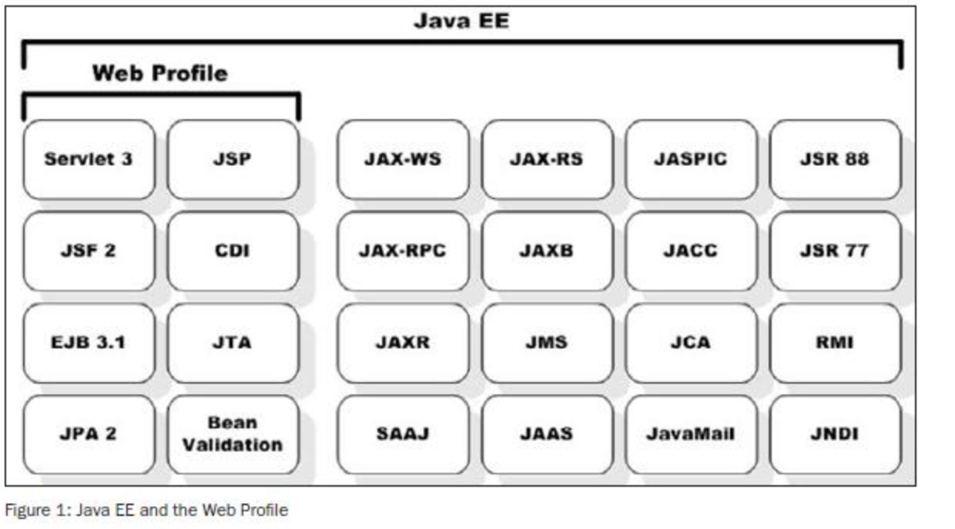
JEE Specs https://jaxenter.com/introducing-the-java-ee-web-profile-103275.html

Slide 32
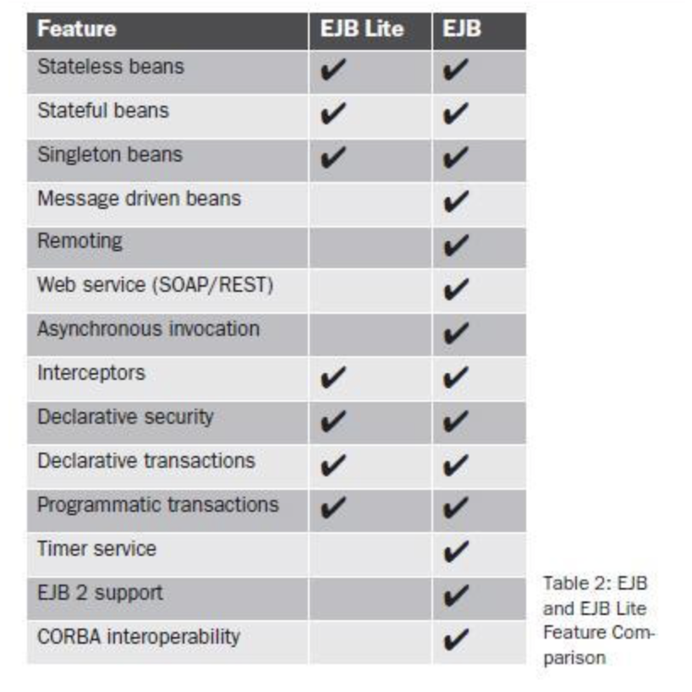
EJB Lite vs EJB https://jaxenter.com/introducing-the-java-ee-web-profile-103275.html

Slide 33
Addressbook application
Glassfish
Named Bean
ContactController
EJB
ContactFacade
Contact.class
Browser
Web Pages
JSF
*.xhtml
Database

Slide 34
Tiered Applications
Presentation Layer
Client Side Presentation
Server Side Presentation
Business Layer
Data Layer

Slide 35
Persistence JPA
In this SlideDeck
Continue introduction to Jakarta EE
Programming and troubleshooting
Deeper dive into Java Persistence

Slide 36
Addressbook application
Glassfish
Named Bean
ContactController
EJB
ContactFacade
Contact.class
Browser
Web Pages
JSF
*.xhtml
Database

Slide 37
Jakarta EE Intro: Tiered Applications
Presentation Layer
Client Side Presentation
Server Side Presentation
Business Layer
Data Layer

Slide 38
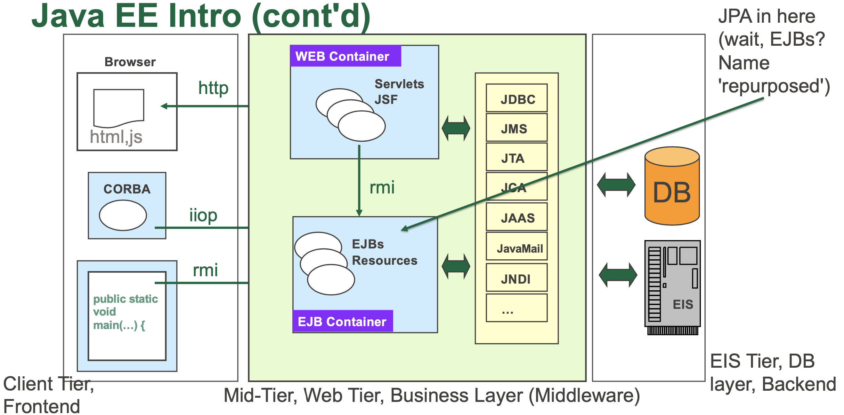

Slide 39
Restaurant Analogy (3-tier applications)
User’s Home
User’s Car
User’s tables
User’s chairs
User’s mobile?
Employee Area
RESTful API
Takeout/Drivethru
Kitchen
Backend
Recipes =
Business Rules
Counter
Frontend/Backend
Transition
Food Ingredients
Dining
Room
Tables
Chairs
Napkins
Cashiers
Cash Register
Cashier is stateless
or
Waiter is stateful
Walk-in cooler
Walk-in freezer

Slide 40
JEE Programming and Troubleshooting
Often there are multiple ways of accomplishing a task: example – creating an Entity class Java file
If there is an existing database table that represents the entity, you can
Right-click->New Entity Classes from Database
This gives us a rough starting point, and we adjust the code to be what you need
We do this in Lab1, Lab2
If there is an existing Entity class Java file that's close to what you need, you can
Copy and paste the Java file into a package in our project
This gives us a rough starting point, and we adjust the code to be what you need
We can right-click->New Entity Class
This gives you a very basic starting point and you add the code to make it what you need
You can use any text editor (including the IDE) to type in the code you need
Remember that YOU are the programmer: notice that in all options, YOU are responsible for make the code what you need

Slide 41
Annotations
A large part of programming with the JEE framework is using annotations
Annotations apply to the Java code below the annotation
In other words, we put the annotation in the source code above the Java artifact that we want to annotate
We Annotate various java programming artifacts, for example
Class definitions: public class SomeClass ...
Variable declarations: private Integer quantity …
Method declarations: protected EntityManager getEntityManager() {

Slide 42
What to do when things go wrong…
One of the main goals of programming is to determine what is going wrong
If it appears nothing is going wrong, then we are still not finished, because we need to do proper testing
How do we figure out what is wrong?
It is a little more complicated with the Enterprise Edition, because the problem might not occur until it runs on the Glassfish server (this is often the case)
Luckily, Netbeans shows us the "Server Log", named "Glassfish Output"
When you see the message "see server log for details", that is not an error message – that's Netbeans telling you something went wrong "on the server"
We can view the Glassfish output, and look at the bottommost stacktraces to see what the Glassfish server thinks went wrong (this is usually our best hope of figuring out the cause of runtime errors)

Slide 43
Demonstration of things going wrong
Let's try inserting a few problems, and see what happens
This is a live demonstration, what could go wrong?

Slide 44
Java EE Intro (cont'd)
EE: Container-based Software Development/Deployment
Standard Edition (SE) vs Enterprise Edition (EE)
Java SE – all important artifacts on the classpath; if developed 'from-the-ground-up' need to handle
Multithreading, networking, resources, protocols, services, transactions, asynch messaging, security (and more)
Java EE – provides services/capabilities for all above:
Focus on meeting customers needs: business logic, persistence
Services compartmentalized into 'Containers’
No public static void main(String args[]){…}
App is not run from command-line/classpath – App is deployed to server (for some definition of 'deploy')

Slide 45
Java EE Intro (cont'd)
Java EE Server provides Containers ...
Web Container: manage execution of components that handle web pages, Servlets, JSP/JSF ...
EJB Container: manage execution of EJB components that handle persistence to the database and Business Logic
Application-client Container: additional components that allows Java SE apps to interact with Server (lookup, remote invocation)
Applet Container: manage execution of components (Applets) that run in a Browser's Java plugin (Applets are avoided due to security issues)

Slide 46
JavaBeans Components
A JavaBean is a Plain Old Java Object (POJO), but with certain characteristics
JavaBeans conform to naming and design conventions:
all attributes are private
there are get and set methods (adhering to naming conventions) for accessing all attributes
an attribute with such getter and setter methods is called a property
so now we may use "property" two ways: 1. generally as a synonym for "attribute", or 2. as an attribute together with getter and setter methods adhering to JavaBeans naming conventions
Enterprise JavaBeans are a specific kind of JavaBean, a component of JEE applications
@Stateful
@Stateless
@Singleton
Named Beans are not EJBs, but are managed and have a name:
@Named

Slide 47
JavaBeans Components (continued)
JavaBeans are POJOs with properties
Property is an attribute with a getter and setter (naming conventions):
private int age;
public void setAge(int age) {
this.age = age;
}
public int getAge(){
return age;
}

Slide 48
Java EE Intro (cont'd)
There are two types of Enterprise Java Beans
Session – perform task(s) for some client; optionally a 'Web Service' Message-Driven – listens for (specific) message events from Java Message Service (JMS)
Allows App Server to process messages asynchronously
Session Beans come in 3 types:
Stateless Session Bean – Business logic, does not maintain state with each client
Stateful Session Bean – Business logic, does maintain state with each client
Singleton Session Bean – Session bean that is a singleton, does not keep state with clients

Slide 49
Java EE Intro (cont'd)
Glassfish 5 is the RI for Java EE
2005 - Sun Java System Application Server (SJSAS)
that’s why all the commands start with ‘asadmin ...’
J2EE version 1.4
2018 – Transfer to Eclipse Foundation
Eclipse Enterprise for Java (EE4J) – new home for all Java EE technologies, mailing lists, IP, etc.
err, except for Java EETM trademark - Oracle’s lawyers said ‘No’, so Eclipse Foundation asked community to vote: result ‘Jakarta EE’

Slide 50
Java Naming and Directory Interface (JNDI)
Allow us to interact with Naming and Directory Services – e.g.
Common Object Services (COS) – CORBA object references
Remote Method Invocation (RMI)
Lightweight Directory Access Protocol (LDAP) – corporate phone book; DNS
Our apps use JNDI to look up DataSources
Example: java:comp/DefaultDataSource
Name lookup: find name associated with an object
import javax.naming.InitialContext; ... Context ctx = new InitialContext(); DataSource ds = (DataSource)
ctx.lookup("java:app/jdbc/H2Pool");
or navigate to specific point, lookup from there
Context envContext = ctx.lookup("java:/app"); DataSource ds = (DataSource)
envContext.lookup("jdbc/H2Pool");

Slide 51
JNDI cont’d
Java EE has special ‘root’ namespace "java" with standard sub-contexts:
:global – portable way to find remote EJBs on other servers
:module – find local EJBs within same module (.war file)
:comp – subtree reserved for component-related bindings
:app – find local EJBs within same app (.ear file)

Slide 52
Packaging Java EE applications
A web-module is the smallest deployable/usable unit of resources packaged in a Web Archive (.war file - same as a .jar file) with a specific directory layout:
top-level directory is document ‘root’ of the package - .(x)html, .css files, images
subdirectory WEB-INF/ contains files and subdirectories:
classes/ - contains servlets, EJBs ('loosely'), other EE components
lib/ - contains (3rd-party) library .jar files; EJBs can also be packaged in .jar files within WEB- INF/lib
deployment descriptors - web.xml, ejb-jar.xml, vendor-specific descriptor files e.g. glassfish-resources.xml
persistence.xml – must be in either
WEB-INF/classes/META-INF/persistence.xml, or
WEB-INF/lib/MyEntities.jar and within MyEntities.jar must be META-INF/persistence.xml

Slide 53
Packaging Java EE applications (cont’d)
An Enterprise Archive (.ear file) is the recommended packaging for large applications that contain multiple modules
Top-level directory is document ‘root’ of the .ear file & contains
1 or more web-modules(s) packaged in .war files
1 or more EJB modules(s) packaged in .jar files
1 or more RAR (Resource Adapters) modules(s) packaged in .rar files
Library files – 1 or more (3rd–party) .jar files
Java EE application deployment descriptor application.xml file, within WEB-INF
Maven has plugins for both .war and .ear layouts that automates packaging the App

Slide 54
Java Persistence
Managing Persistence is the top challenge in Enterprise Java
If Objects (instances of entity classes) are the data, then how do we
Query the data
Create the data
Update the data
Delete the data

Slide 55
Persistence Units
A persistence unit is
The set of entity classes to be managed by the EntityManager (there is one entity class in our case)
A database connection where the database table(s) corresponding to the entities reside
Persistence units are defined using a file called persistence.xml
Programmers (ContactFacade.java) associate a persistence unit with an EntityManager using a @PersistenceContext annotation:
@PersistenceContext(unitName = "address-bookPU")
protected EntityManager em;

Slide 56
Session Façade design Pattern
All the gory details: https://www.oracle.com/java/technologies/session-facade.html
We use a Session Façade (stateless Session Bean, @Stateless) ContactFacade.java to encapsulate interactions with the database
The JSF backing bean for the presentation layer pages, ContactController.java obtains a reference to a ContactFacade through Context Dependency Injection (CDI, @EJB, or @Inject)

Slide 57
Object-Relational Mapping
ORM (Object-Relational Mapping)
Maps objects in Java to entities in DB
Purpose is to allow Java programmers to treat DB as if it stores objects
Database E/R (Entity/Relationship) terminology
'Person' is an Entity -> managed via PERSON table
Attribute of 'Person' -> managed via column in PERSON table
ORM simplified
Entity corresponds to Class
Attribute corresponds to member field of Class
Row corresponds to instance of Class (a.k.a. an object)
A single object can be mapped to multiple rows in multiple tables:
@Entity
@Table(name="myEmployee") // specify a table name not exactly derived from class name @SecondaryTable(name="moreEmployeeStuff") public class Employee

Slide 58
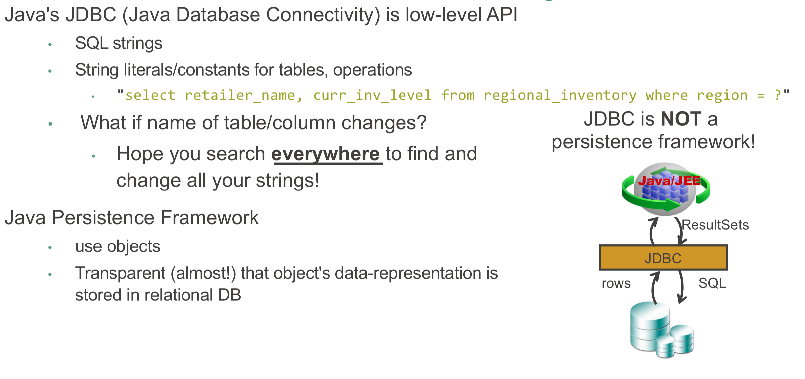
Why not just JDBC?

Slide 59
JPA vs JDBC
JPA provides:
• Productivity
helps developers get rid of writing complex and tedious SQL statements
developers concentrate on the business logic
• Maintainability
helps reduce the amount of code: a system with less code is more easier to refactor
system more understandable
• Portability
App isolated from Database vendor's dialect, idiosyncrasies
Switching to different Database vendor typically requires minimal changes: config, rarely source

Slide 60
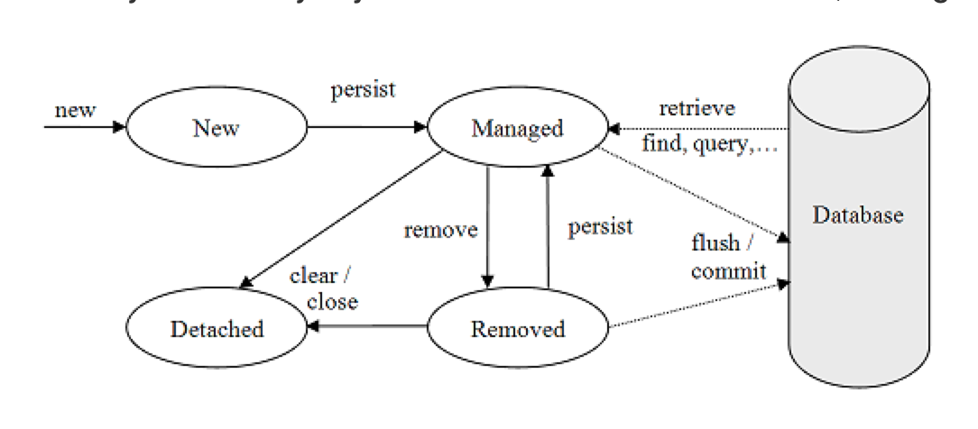
JPA Entity Lifecycle

Slide 61
JPA Entity Lifecycle (cont’d)
A newly created entity is in the New state not associated with an entity manager
A newly created entity becomes Managed when it is persisted by the entity manager’s persist method (stored to database upon commit)
Entities retrieved from the database are in the Managed state
Entities are put in Removed state by the entity manager’s remove method (deleted from database upon commit)
Entities are Detached if the entity manager is closed/cleared (can be merged back to an entity manager)

Slide 62
Entity Classes
Entity Classes are identified with the @Entity annotation
Java class fields/properties in an Entity Class are annotated according to their purpose in the entity
@Id annotation specifies which field is the primary key (always a long int, for us, and this is generated automatically, hidden from the user
@Column annotation identifies fields which should be stored in database (all fields stored by default)
@Column(name="STUDENT_NAME", length=50, nullable=false, unique=false)
private String name;
@Transient annotation identifies fields/properties which should not be stored in the database

Slide 63
Field vs Property access
When the field variables themselves are annotated, that is "Field access"
When the getter method is annotated instead, that is "Property access"
What's the difference? Difference is how the field variables are populated by JPA when retrieving an object from the database (using the getter/setter methods, or alternatively accessing the field variables directly)
In our applications we will be able to accept what Netbeans provides for us

Slide 64
How a Class Becomes an Entity
import javax.persistence.Entity; import javax.persistence.GeneratedValue; import javax.persistence.GenerationType; import javax.persistence.Id; import javax.persistence.Table; @Entity @Table(name="acme_employees") // if @Table annotation not used, table name derived from class name public class Employee { private int empId; // member fields are not annotate; Hibernate will use JavaBean property get/set methods private String empName; // annotate field, or properties – never both ... // @Column annotation not really needed, all attributes will be persisted unless @Transient annotation is used public String getName() { return empName; } public void setName(String name) { this.empName = name; } @Id @GeneratedValue(strategy=GenerationType.IDENTITY) // Hibernate will use H2's auto-generated PK values public int getId() { return empId; }
Public void setId(int id) { ...

Slide 65
JEE Tutorial: Address Book
Overview of address_book
https://docs.oracle.com/javaee/7/tutorial/persistence-basicexamples003.htm
Source Code
https://github.com/javaee/tutorial-examples/tree/master/persistence/address-book
Address Book is a CRUD application: View/Create/Edit/Remove contact entities

Slide 66
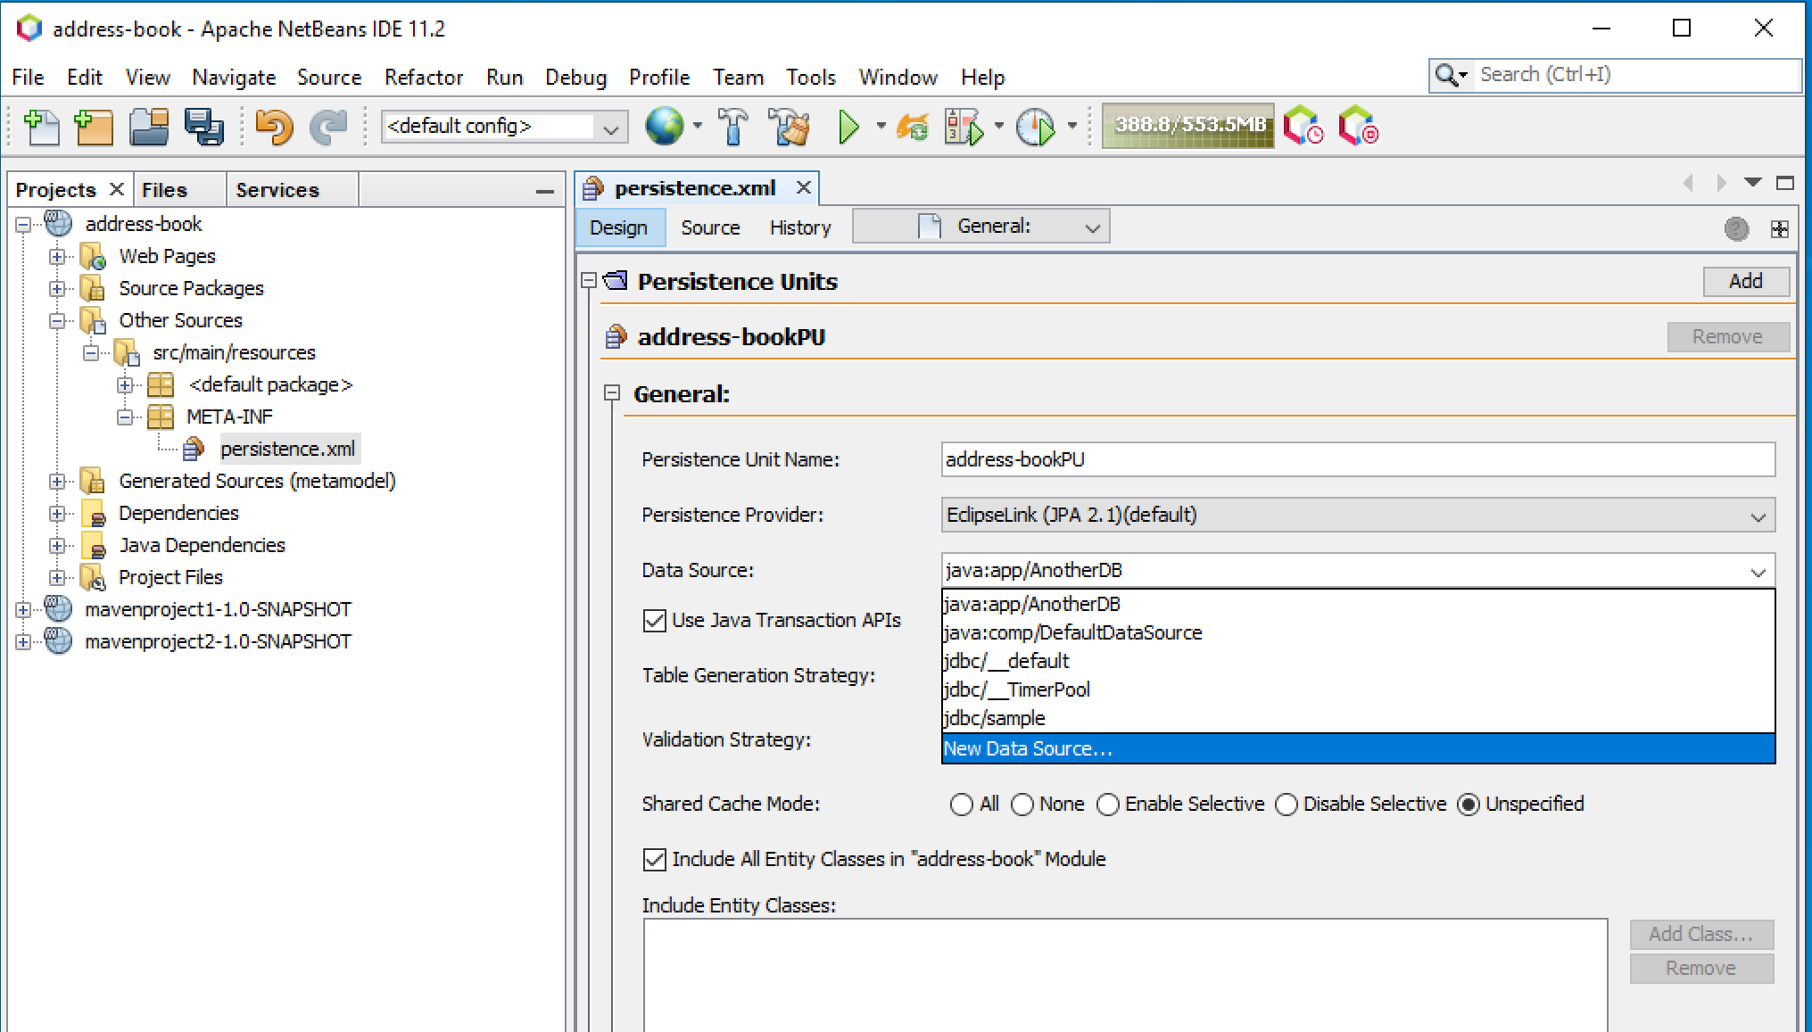
Creating a DataSource

Slide 67
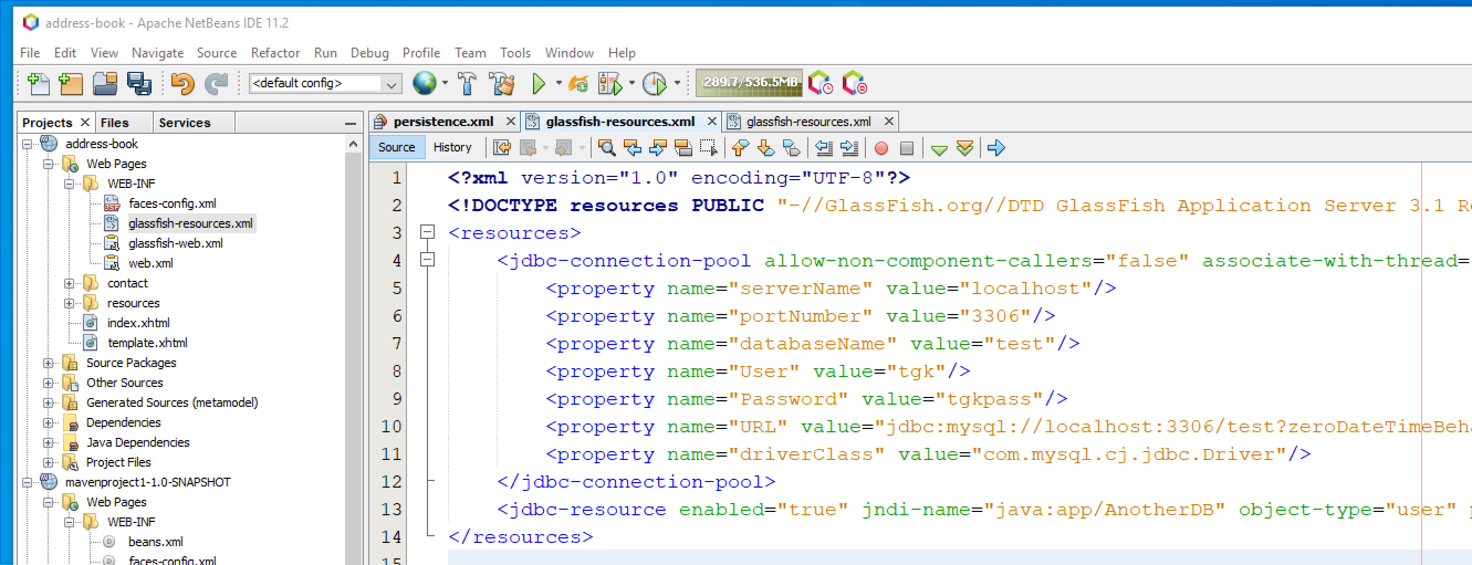
Connection To Database
After creating a DataSource (previous slide), glassfish_resources.xml stores the information to link the jndi DataSource name to real database engine information
User and Password for the database engine are stored here

Slide 68
Intersection of Specification and Implementation
Specification
persistence.xml specifies the DataSource name:
<jta-data-source>java:app/AnotherDB</jta-data-source>
Implementation
glassfish_resources.xml specific to the Glassfish Server (Reference Implementation), links the DataSource java:app/AnotherDB to a JDBC connection pool
JNDI names can be looked up using the Java Naming and Directory Interface (JNDI)

Slide 69
Abstract Persistence Unit Name
<?xml version="1.0" encoding="UTF-8"?>
<persistence version="2.1" xmlns=http://xmlns.jcp.org/xml/ns/persistence
xmlns:xsi=http://www.w3.org/2001/XMLSchema-instance
xsi:schemaLocation="http://xmlns.jcp.org/xml/ns/persistence
http://xmlns.jcp.org/xml/ns/persistence/persistence_2_1.xsd">
<persistence-unit name="address-bookPU" transaction-type="JTA">
<provider>org.eclipse.persistence.jpa.PersistenceProvider</provider>
<jta-data-source>java:app/AnotherDB</jta-data-source>
<exclude-unlisted-classes>false</exclude-unlisted-classes>
…

Slide 70
glassfish_resources.xml binds JDBC pool to DataSource JNDI name
<resources>
<jdbc-connection-pool [...] name="mysql_test_rootPool" [...] >
<property name="serverName" value="localhost"/>
<property name="portNumber" value="3306"/>
<property name="databaseName" value="test"/>
<property name="User" value="root"/>
[…]
</jdbc-connection-pool>
<jdbc-resource enabled="true" jndi-name="java:app/AnotherDB" object-type="user" pool-name="mysql_test_rootPool"/>
</resources>

Slide 71
JDBC Pools
The previous slide shows that, for the java:app/AnotherDB DataSource, Glassfish should use a jdbc-connection-pool called mysql_test_pool
The JDBC connection pools are “pools” because a typical enterprise app with many simultaneous users may need many simultaneous connections to the database.
JDBC connections are drawn from a ready-to-go pool of database connections
Programmers use the JPA in part with lines of Java like getEntityManager().persist(newEntity);
and the JPA implementation uses a JDBC connection from the pool to communicate with the database

Slide 72
JPA Criteria API Querying
@PersistenceContext(unitName = "address-bookPU")
protected EntityManager em;
... public List<T> findAll() {
javax.persistence.criteria.CriteriaQuery cq =
getEntityManager().getCriteriaBuilder().createQuery();
cq.select(cq.from(entityClass));
return getEntityManager().createQuery(cq).getResultList();
}
…
public List<T> findRange(int[] range) {
javax.persistence.criteria.CriteriaQuery cq =
getEntityManager().getCriteriaBuilder().createQuery();
cq.select(cq.from(entityClass));
javax.persistence.Query q = getEntityManager().createQuery(cq);
q.setMaxResults(range[1] - range[0]);
q.setFirstResult(range[0]);
return q.getResultList();
}

Slide 73
More Info on Criteria API
https://www.objectdb.com/java/jpa/query/criteria
https://javaee.github.io/javaee-spec/javadocs/javax/persistence/criteria/package-summary.html

Slide 74
Cloned-Addressbook RESTful API
Glassfish
Postman
JAX-RS
EJB
ContactFacadeREST
Contact.class
Database

Slide 75
RESTful API
REST is an architectural style often used for Web Services
REpresentational State Transfer
State of the Art for decoupling (scalable, flexible)
Resources are retrieved and manipulated through URIs and using the methods GET, PUT, POST, DELETE
Data exchanged in XML and/or JSON formats
We can ask Netbeans to create a REST interface for us based on an existing table

Slide 76
REST constraints
A RESTful interface satisfies the following contstraints:
Client-Server
Stateless
Cacheable
Uniform Interface
Layered System
Code-On-Demand (optional)

Slide 77
Uniform Interface with HTTP
HTTP request (URL, method, headers and body)
HTTP Methods are the Verbs (examples: GET,POST,PUT,DELETE)
URLs represent the nouns (resource name)
http://www.myserver.com/myresource
State Representation (json, xml)
{{name: "Todd"}}
<element_list>
<some_element>
<name> Todd </name>
</some_element>
</element_list>
HTTP response (status, headers and body)

Slide 78
REST URIs (URLs)
REST URLs identify resources
The entire contact table:
http://localhost:8080/mavenproject1/resources/com.mycompany.mavenproject1.contact
GET http method will respond with XML or JSON representing all rows in contact table
POST http method will update the entire contact table ( by creating a sub-resource)
PUT http method would create or replace the entire contact table
The row of the contact table with id=1
http://localhost:8080/mavenproject1/resources/com.mycompany.mavenproject1.contact/1
HTTP methods same as above, except just operate on row with id=1
The range of rows with ids from 1 to 3
http://localhost:8080/mavenproject1/resources/com.mycompany.mavenproject1.contact/0/3
The count of the number of rows in the contact table:
http://localhost:8080/mavenproject1/resources/com.mycompany.mavenproject1.contact/count

Slide 79
Idempotent and PUT vs POST
PUT method is intended to be idempotent; POST is not
Idempotent: calling it once or many times successively has the same effect
Think of a Buy button on a web page for a product in an online store:
Click the buy button three times:
Idempotent buy button: we bought one
Non-itempotent buy button: we may have bought three
Think of an Increment button:
Click the increment button three times:
Idempotent increment button would always set the same value and wouldn't work as intended
Increment button working as expected (increasing by 3) would be non-idempotent

Slide 80
REST vs HTTP
REST is a set of constraints on an architecture
HTTP is a protocol that supports those constraints
A “RESTful interface” or “REST interface” in this course means “an HTTP interface implemented properly, and that satisfies the REST constraints”

Slide 81
HTTP vs HTML vs XML
Easy one!
HTML is a markup language for defining/creating hypertext
HTML is closely related to XML, but this HTML is not well-formed XML
<html>
<body>
Hi
<br>
Hi again. There is no closing tag on the br element, so this cannot true XML
<br>
</body>
</html>
HTTP is a transfer protocol for transferring hypertext

Slide 82
Application for testing RESTful interface
There is a built-in Netbeans tool for testing HTTP APIs but instead, we will use Postman
Postman allows us to build arbitrary http requests, and examine the associated responses returned by the server
Postman will encourage you to signup and signin, but you can download and use it without creating an account
Download link: https://www.getpostman.com/downloads/

Slide 83
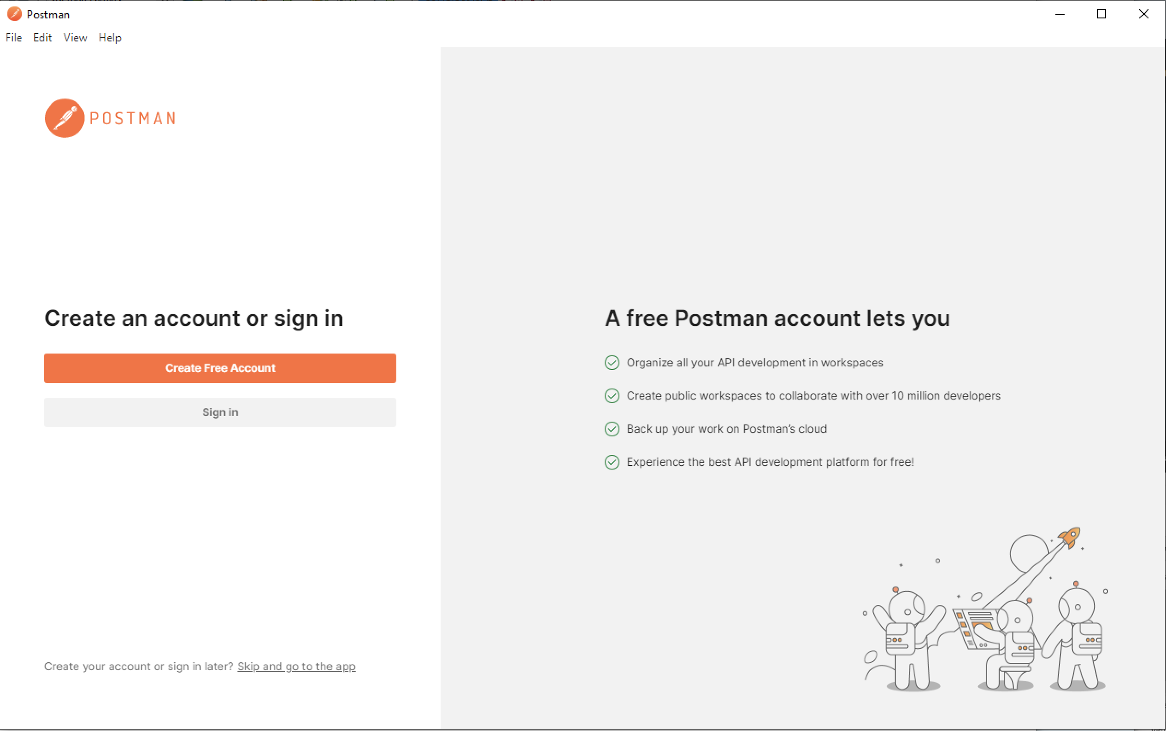
Postman

Slide 84
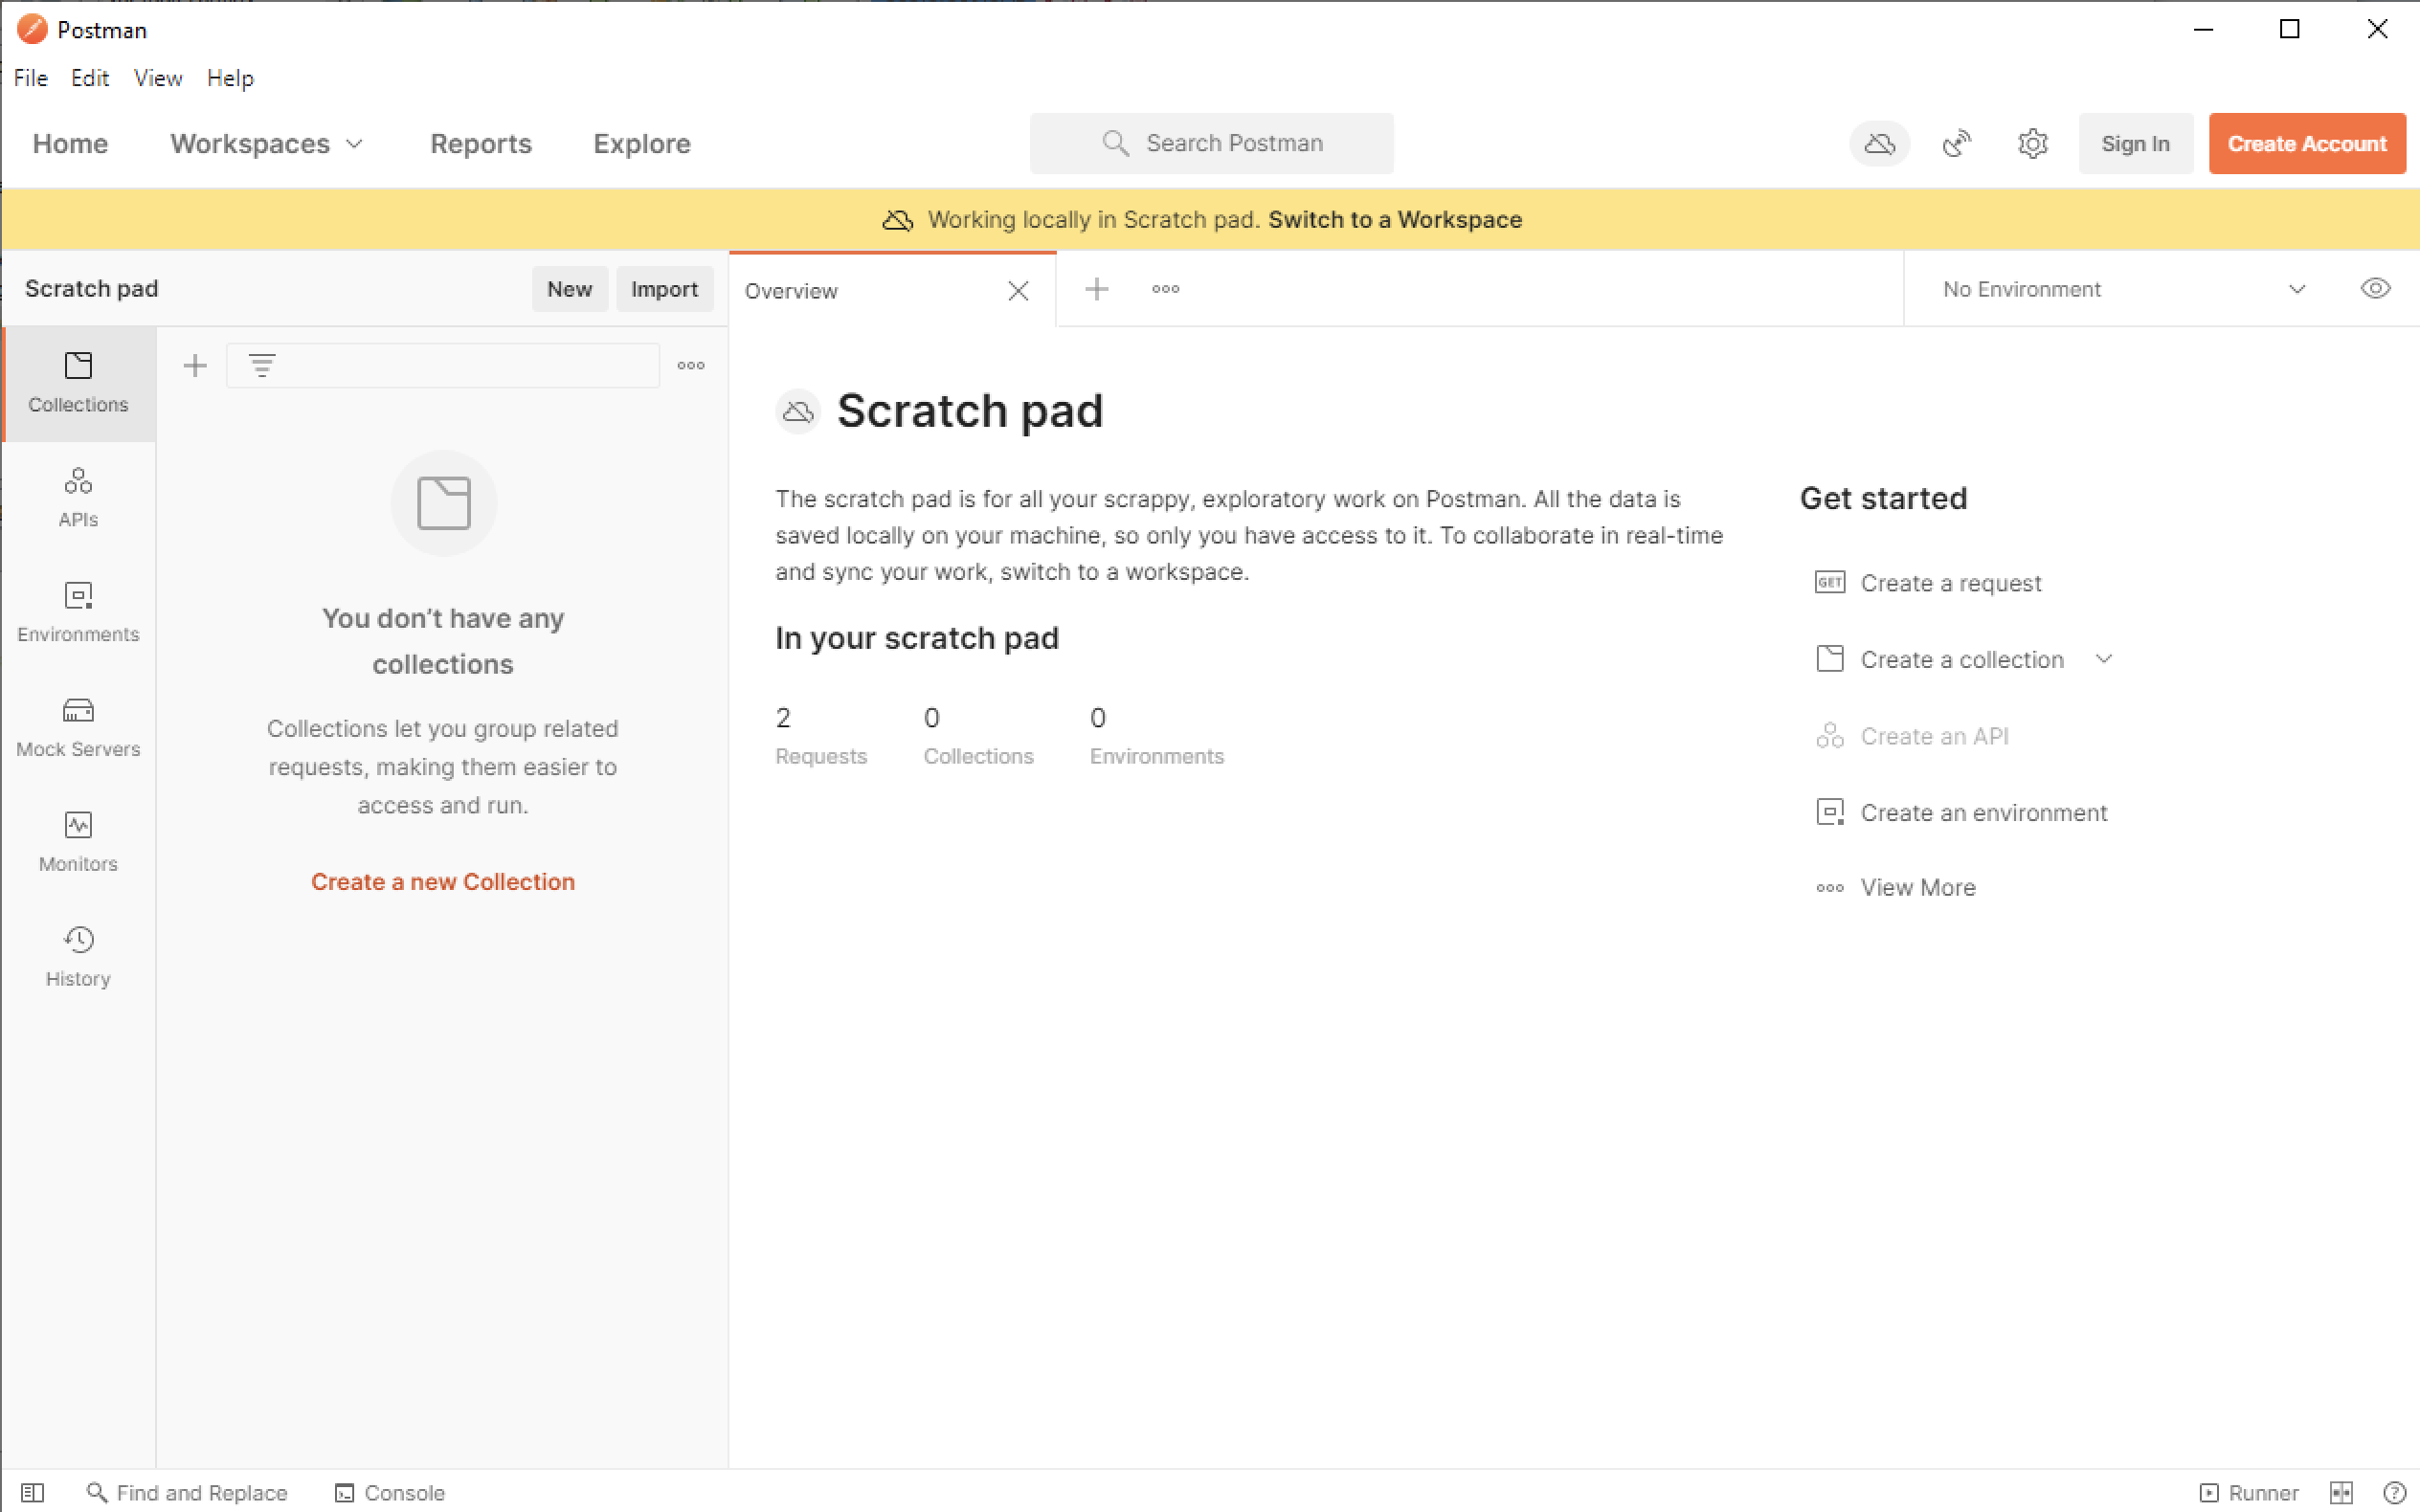
Postman

Slide 85
HTTP Protocol
Hyper Text Transfer Protocol
Hypertext is the term used for documents that contain links to other documents and resources
REST architectural style was developed by Roy Fielding in concert with HTTP 1.1 based on the design of HTTP 1.0
HTTP 1.1 was designed to be RESTful, and ”REST interface” is an informal way to say RESTful HTTP API or RESTful HTTP interface
HTTP specification: https://tools.ietf.org/html/rfc7231
HTTP 1.1 is RESTful if used properly

Slide 86
HTTP Messages (requests and responses)
Both requests and responses have
Start-line: describe the request to be implemented, or its status of whether successful or a failure.
HTTP headers: (optional) specify the request, or describe the body included in the message.
Blank Line
Body: contains data associated with the message (ofen HTML, JSON,or XML) The presence of the body and its size is specified by the start-line and HTTP headers.

Slide 87
HTTP Requests
start-line includes:
an HTTP method, like GET, PUT, POST, DELETE that describes the action to be performed (verb)
The request target: usually a URL (noun)
HTTP version
Headers include
General headers, like Via, apply to the message as a whole.
Request headers, like User-Agent, Accept-Type, modify the request by specifying it further (like Accept-Language), by giving context (like Referer), or by conditionally restricting it (like If-None).
Entity headers, like Content-Type and Content-Length which apply to the body of the request. Obviously, there is no such header transmitted if there is no body in the request.
Body
Not all requests have bodies
Single-resource bodies defined by Content-Type and Content-Length
Multiple-resource bodies have multiple parts (typically associated with HTML forms)

Slide 88
HTTP Responses
Status Line
Protocol version, usually HTTP/1.1
Status code indicating success or failure of request.
Status text: a brief textual description of the status code to help a human
Example: HTTP/1.1 404 Not Found.
Headers
Similar to headers of an HTTP Request
Body
Optional
Single resource bodies with Content-Type and Content-Length (we’ll see these ones in our HTTP APIs)
Single resource bodies with a single file of unknown length
Multiple resource bodies with different sections (relatively rare)

Slide 89
RESTful APIs with JAX-RS
See Hybrid Activity on JAX-RS
JAX-RS (Restful Services) is the Jakarta EE API that we use to implement RESTful APIs to our applications
We use JAX-RS by adding to our project a class that extends javax.ws.rs.core.Application and using (drum-roll….) ANNOTATIONS
From our cloned address-book applications, in JAXRSConfiguration.java
import javax.ws.rs.ApplicationPath;
import javax.ws.rs.core.Application;
@ApplicationPath("resources")
public class JAXRSConfiguration extends Application {
}

Slide 90
JAX-RS resources
After JAX-RS is configured by extending Application and specifying an ApplicationPath (see previous slide)
We specify resources by putting the @PATH annotation on a resource class or method
We specify applicable methods for a @PATH using an annotation corresponding to the HTTP method:
@GET
@POST
@PUT
@DELETE
These annotate the JAVA method that is run to service that method request
Example from our cloned address-book (don't delete it this time!)
@Path("sample")
public class SampleResource {
@GET
public Response message() {
return Response.ok("Hello World").build();
}
}

Slide 91
RESTful API for CRUD operations
Netbeans can generate (a starting-point initial version of) a RESTful API for CRUD operations on an Entity:
right-click->new->RESTful Web Services from Entity Classes
This starting point API is fine for Lab 3 but it won't satisfy the requirements you're asked for in the Assignments: you'll need to make adjustments to the API when you do your Assignments

Slide 92
Maven basics
For details https://maven.apache.org/what-is-maven.html
Maven is a software project management system
Similar ideas: make, Ant, Gradle
Based on the concept of a Project Object Model (pom)
pom.xml is our maven configuration file
In tutorial-examples-master projects, the parent directory's pom also applies
When we create a project with maven, it is structured according to an archetype (a pattern or model for how things are structured)
Handles dependencies : you've probably seen this in action already
Controls the build cycle, with phases such as clean, compile, etc
Example: let's configure maven to ignore the JSF jar file that Windows can't delete during the clean phase

Slide 93
Agenda
New JavaServer Faces Hybrid activity
CSI
JavaServer Faces

Slide 94
Cloned-Addressbook RESTful API
Glassfish
Postman
JAX-RS
EJB
ContactFacadeREST
Contact.class
Database

Slide 95
Cloned-Addressbook RESTful API
Glassfish
Postman
JAX-RS
EJB
ContactFacadeREST
Java Client
XML
JSON
Contact.class
Database

Slide 96
Addressbook application
Glassfish
Named Bean
ContactController
EJB
ContactFacade
Contact.class
Browser
Web Pages
JSF
*.xhtml
Database

Slide 97
JEE Java Server Faces (JSF)
JSF https://docs.oracle.com/javaee/7/tutorial/jsf-page.htm#BNAQZ
Validators, Converters https://docs.oracle.com/javaee/7/tutorial/jsf-page-core.htm
Backing Beans: https://docs.oracle.com/javaee/7/tutorial/jsf-develop.htm#BNATX
Expression Language: https://docs.oracle.com/javaee/7/tutorial/jsf-el.htm#GJDDD

Slide 98
JavaServer Faces Technology
A JEE-integrated GUI component framework for building web applications
JSF pages are implemented behind the scenes with servlets and Java Server Pages technology (we do not program servlets or JSP directly in this course)
Features supporting GUI components:
Input validation
Event Handling
Data conversion between model object values and GUI components
Page navigation configuration
Expression Language (EL)

Slide 99
JavaServer Faces
JavaServer Faces pages form the presentation layer for JEE web applications
Programmer uses component tags to add components to a page
The GUI components on a page form a tree called the View
These components are “wired” to
backing beans,
validators,
converters, and
other server-side objects

Slide 100
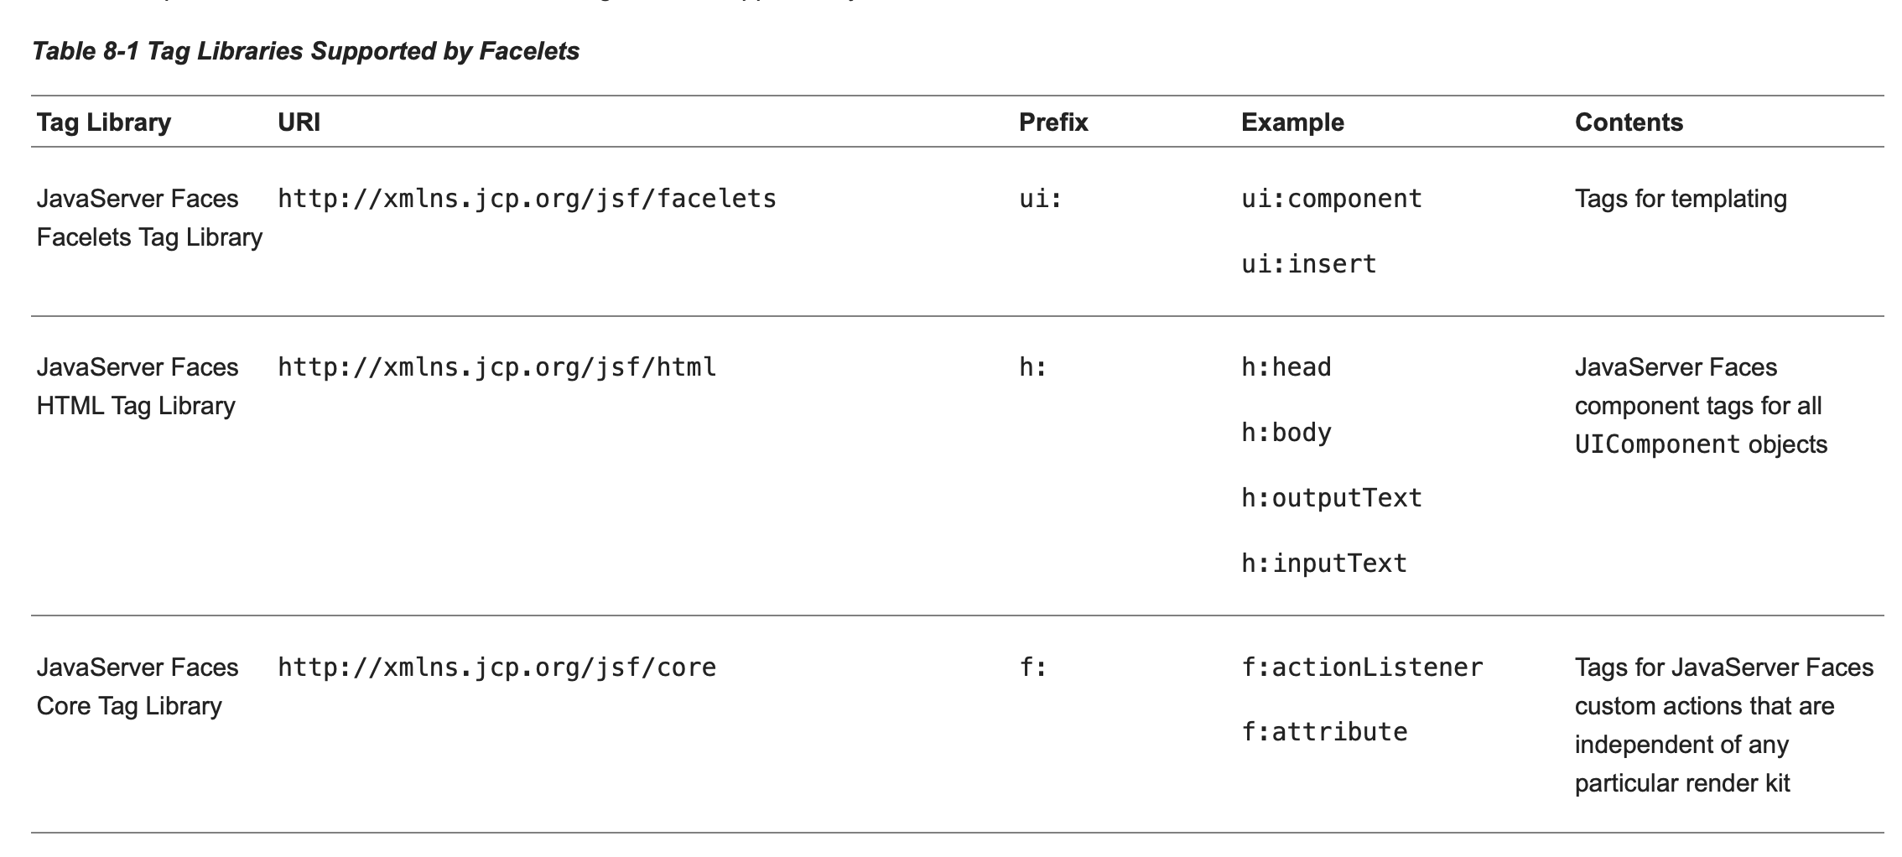
JSF Tag Libraries
The tags used on JSF *.xhtml pages are from tag libraries
The prefixes correspond to XML namespaces declared at top of page
From https://docs.oracle.com/javaee/7/tutorial/jsf-facelets001.htm

Slide 101
Facelets Templating
The addressbook (and our clones of it) use Facelets Templating
Many details can be found here: https://docs.oracle.com/javaee/7/javaserver-faces-2-2/vdldocs-facelets/ui/tld-summary.html
For our purposes we only need to know the following about templating
The template.xhtml file defines a template into which has slot for
ui:insert shows where title should be inserted
ui:insert shows where the body should be inserted
The JSF pages *.xhtml files reference the template
ui:composition specifies the template file to use (template.xhtml)
ui:define identifies what elements should be inserted into which slots of the template

Slide 102
Named Beans
lightweight container-managed objects (POJOs)
The @Named (javax.inject.Named) annotation in a class, along with a scope annotation, automatically registers that class as a resource with the JavaServer Faces implementation
Example ShoppingCart class:
@Named("cart")
@SessionScoped
public class ShoppingCart ... { ... }

Slide 103
Named bean scopes
Application (javax.enterprise.context.ApplicationScoped): Application scope persists across all users' interactions with a web application.
Session (javax.enterprise.context.SessionScoped): Session scope persists across multiple HTTP requests in a web application.
Request (javax.enterprise.context.RequestScoped): Request scope persists during a single HTTP request in a web application.

Slide 104
JSF page lifecycle
Begins when a new page is requested
Ends when the HTML page is sent in response
Tree of components on the page is called the view
Two types of request:
Initial request : request page for the first time (reading context)
Restore view : creates empty view
Render response : empty view is populated with the components referenced by the tags in the page (reading context for EL)
Postback request : user submits the form (writing context)
Restore view : restores the view by using the state information saved on the client or the server
Apply request values: each component in the tree extracts its new value from the request parameters
Process validations: processes all validators registered on the components
In case of validation failure go to Render response creating page showing errors
Update model values: traverses component tree, setting the Entity instance properties (writing context for EL)
In case of failure (can’t convert?), go to Render response creating page showing errors
Invoke Application : invokes the method specified by Expression Language
Render Response
In case of errors, this is the original page with error messages added

Slide 105
JSF Overview (initial request)
Glassfish Server
1
Facelet
*.xhtml
Empty
View
2
HTTP
Request
Browser
3
Populate View
Expression Language
Reading context
HTTP
Response
Rendered Page
html
4

Slide 106
JSF Overview (postback request)
Glassfish Server
Restore View
using state info
2
1
Facelet
*.xhtml
3
HTTP
Request
Form Submit
Browser
Populate View
(copy request parameters)
4
HTTP
Response
Process Validations
5
Rendered Page
html
Update Model Values
Expression Language
Write Context
7
6
Invoke Application

Slide 107
JSF page navigation
h:commandLink :
links to another page
Expression language to invoke method that returns the name of the page to navigate to
Example
<h:commandLink action="#{contactController.create}" value="#{bundle.CreateContactSaveLink}" />
When the button is clicked, postback request is sent:
at Invoke Application phase create method runs
create method returns “Create”, which is the next page to display

Slide 108
Faces Validation System
Validation applies to data coming from the user to our program (postback request)
Our Address Book example has the following examples of data validation:
Birthdays of the form DD/MM/YYYY and the date must be in the past
Email addresses match a regular expression representing all email addresses
Phone numbers must be 10 digits

Slide 109
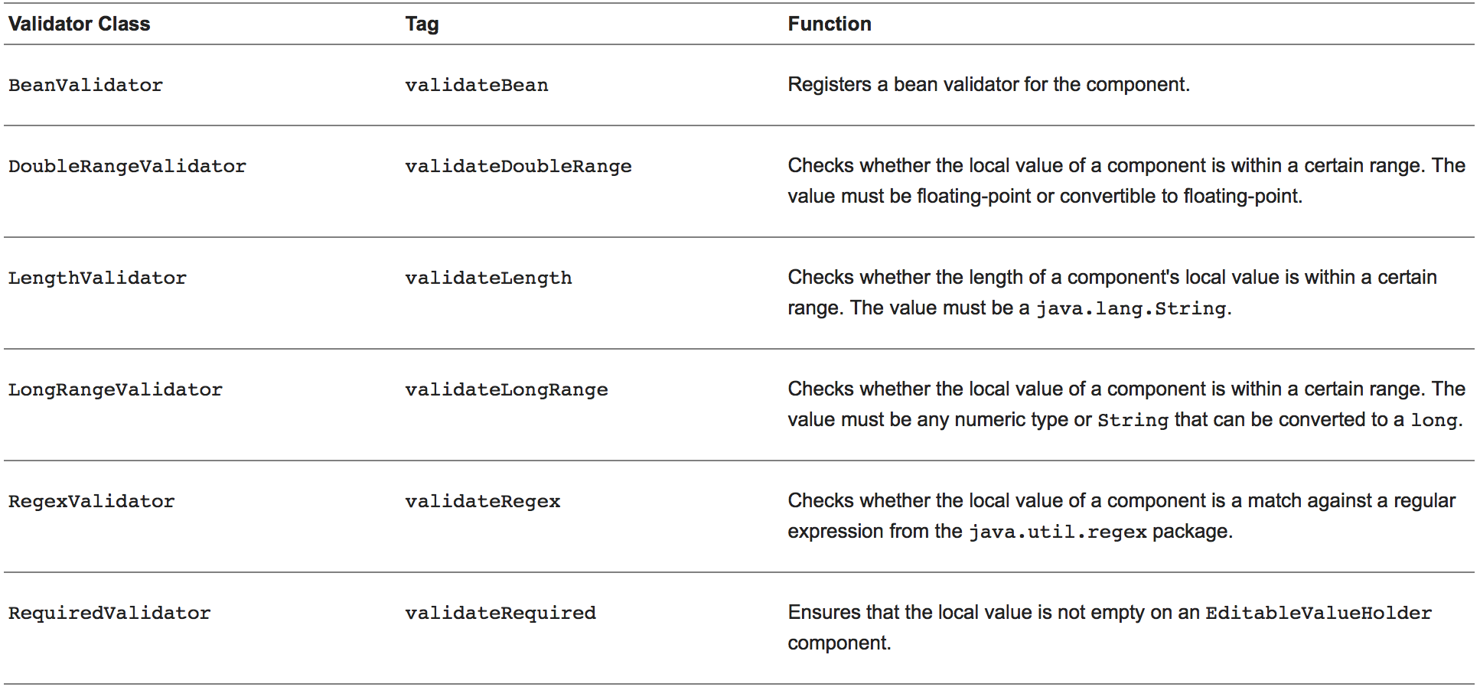
JSF Standard Validators

Slide 110
Validator Example
<h:inputText id="quantity"
size="4”
value="#{item.quantity}"
validatorMessage= "minimum 1 please" >
<f:validateLongRange minimum="1" />
</h:inputText>
<h:message for="quantity"/>
Example only: validatorMessage should be a localized string using a bundle

Slide 111
Custom Validator
Here, MyOwnJavaConv.java is a class that implements the validate method of the Validator interface (see https://docs.oracle.com/javaee/6/tutorial/doc/bnauw.html)
public void validate(FacesContext context, UIComponent component,
Object toValidate) {
…
if ( !valid ) {
FacesMessage errMsg = new FacesMessage(FORMAT_INVALID_MESSAGE_ID);
FacesContext.getCurrentInstance().addMessage(null, errMsg);
throw new ValidatorException(errMsg);
}
}

Slide 112
Custom Validator
Here, MyOwnJavaConv.java is a class that implements the Validator interface
<td><h:inputText id="homePhone"
value="#{contactController.selected.homePhone}"
title="#{bundle.CreateContactTitle_homePhone}" >
<f:validator validatorId=”MyOwnJavaConv” />
</h:inputText></td>
<td><h:message for="homePhone" /></td>

Slide 113
JSF Converter System
Converters are two-way:
the text coming from the user is converted into Java Objects
the Java Objects coming from the program are converted into text
Consider the Birthday field in the Address Book application (Create.xhtml):
<td><h:outputLabel value="#{bundle.CreateContactLabel_birthday}"
for="birthday" /></td>
<td><h:inputText id="birthday"
value="#{contactController.selected.birthday}"
title="#{bundle.CreateContactTitle_birthday}" >
<f:convertDateTime pattern="MM/dd/yyyy" />
</h:inputText></td>
<td><h:message for="birthday" /></td>
SEE: https://docs.oracle.com/javaee/7/tutorial/jsf-page-core001.htm#BNASV

Slide 114
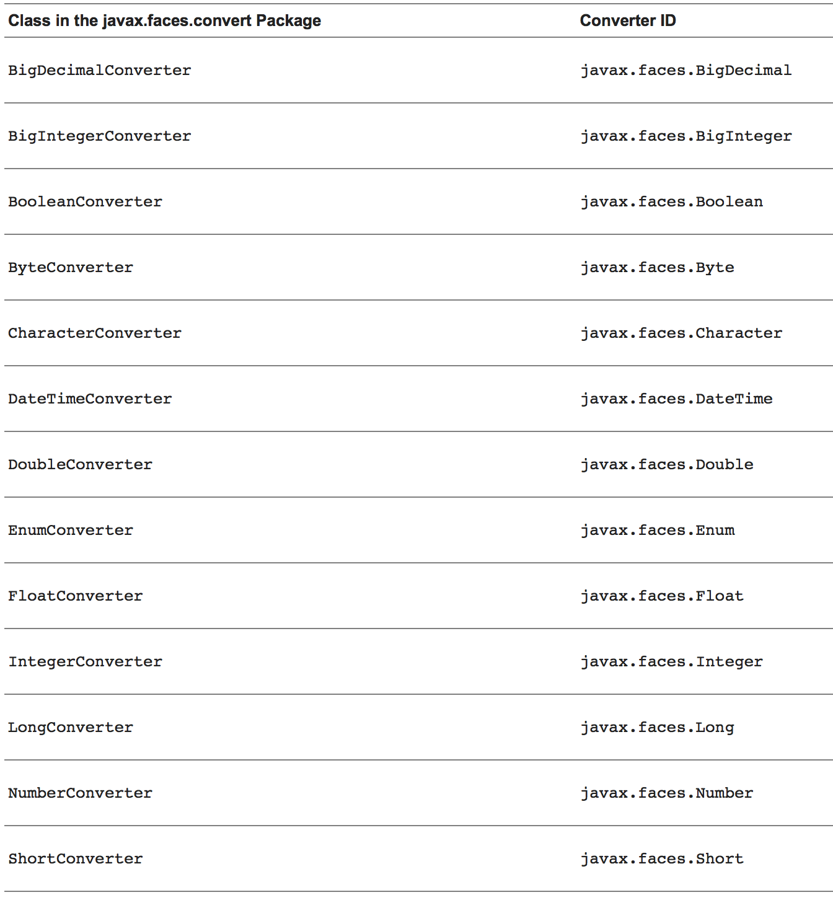
Built-in Converters

Slide 115
Built-in Converters (cont’d)
Built-in Converters are applied implicitly when an Expression Language expression is used (and therefor the datatype is known)
DateTimeConverter has its own <f:convertDateTime> tag
As used in the Address Book example
NumberConverter has its own <f:convertNumber> tag

Slide 116
Custom Converters
Custom Converters implement the javax.faces.convert.Converter interface:
public Object getAsObject(FacesContext context,
UIComponent component, String value)
public String getAsString(FacesContext context,
UIComponent component, Object value)

Slide 117
Custom Converter Example for Credit Card Number
This example uses a converter id "ccno"
Create the converter class
@FacesConverter(“ccno”)
public class MyConverter implements Converter {
// implement the converter interface for creditCardNumber
…
if (there_is_an_error){
FacesMessage errMsg =
new FacesMessage(value + " is not a valid credit Card Number: XXXX YYYY ZZZZ TTTT");
throw new ConverterException(errMsg);
}
…
}
Then use the converter on a field of that type
<h:inputText id="ccno" size="19" value="#{cashier.creditCardNumber}" required="true" requiredMessage="#{bundle.ReqCreditCard}" > <f:converter converterId="ccno"/> </h:inputText>

Slide 118
Custom Converter Example for Color
This example uses the "forClass" attribute to apply to all objects of a class
Create the converter class
@FacesConverter(forClass=Color.class)
public class MyConverter implements Converter {
// implement the converter interface for java.awt.Color
…
if (there_is_an_error){
FacesMessage errMsg =
new FacesMessage(value + " is not a valid color string: #RRGGBB");
throw new ConverterException(errMsg);
}
…
}
JSF pages will use the converter to convert objects of that class

Slide 119
Today's Agenda
Course Section Information
Assignment 1
Lab 4
Hybrid_git
Internationalization/Localization
Internationalize Addressbook (proof of concept)

Slide 120
Addressbook application
Glassfish
Named Bean
ContactController
EJB
ContactFacade
Contact.class
Browser
Web Pages
JSF
*.xhtml
Database

Slide 121
Cloned-Addressbook with RESTful API
Postman
Glassfish
Java Client
XML or JSON
JAX-RS
EJB
ContactFacadeREST
Mobile App
XML or JSON
Browser App
XML or JSON
Contact.class
ContactFacade
Business
B2B
XML or JSON
Browser App
JSF Pages
Database

Slide 122
Internationalization I18n Localization L10n

Slide 123
Suggested Resources
https://www.tutorialspoint.com/jsf/jsf_internationalization.htm
https://docs.oracle.com/javaee/7/tutorial/webi18n.htm

Slide 124
Bilingual Web Applications
Especially important in Government of Canada context
Options:
Splash Page
User is presented with a bilingual splash page
Options for proceeding from the splash page are given by the request’s stated list of locales that the client accepts
Language Selector Control
Combo box allows user to select from a list of languages
Upon selecting a language, the page (and subsequent pages) are displayed in the selected language
Accept-language header
Pages are displayed in the user’s browser-requested language, according to the Accept-language header (more on this below)
Not the best option, because often users will want to override their browser/OS’s language setting.

Slide 125
Internationalization and locales
Internationalization: enabling a web site to provide different versions of content translated into the visitor's language or nationality.
Localization: adding resources to a web site to adapt it to a particular geographical or cultural region, for example, a Hindi translation of the content of a web site.
locale: a particular cultural or geographical region. It is usually referred to as a language symbol followed by a country symbol which are separated by an underscore. For example "en_US" represents English locale for US.
Adapted from: http://www.tutorialspoint.com/jsp/jsp_internationalization.htm

Slide 126
HTTP Accept-language header
Accept-language is an HTTP request header which states which languages the client can understand, and which one is preferred
Example:
Accept-Language: da, en-gb;q=0.8, en;q=0.7
The default weight is 1, so this is equivalent to
Accept-Language: da;q=1, en-gb;q=0.8, en;q=0.7
The weight is normalized to a real number in the range 0 through 1, where 0.001 is the least preferred and 1 is the most preferred
a value of 0 means "not acceptable”
If no "q" parameter is present, the default weight is 1.

Slide 127
What headers is my Browser sending?
Firefox->Inspector->Network
Select the request from the list on the left
Select the Headers tab on the right
View request and response headers
Visit a header-displaying website
Example http://www.xhaus.com/headers

Slide 128
Strings managed in Resource Bundle
In our code, we use symbols, and at runtime, the correct string for that symbol is used
See Bundle.properties in address-book for many examples
These files are called Localization bundles
Create properties file for each supported language
BundleDemo_en_CA.properties
BundleDemo_fr_CA.properties
BundleDemo_en_US.properties
Etc
Files contain lines of the form
Key=String Value
E.g., hello_string=Bonjour

Slide 129
Internationalizing address-book
The localization bundle is configured in faces_config.xml
As we found it, the basename of the localization bundle is configured to be Bundle (could have used different name, like BundleDemo)
We create more languages in files with names of this form: Bundle_<locale>.properties
Examples:
Bundle_en.properties
Bundle_nl.properties
Bundle_es.properties

Slide 130
Internationalizing address-book (cont’d)
Declare supported locales in faces-config.xml:
<application>
<locale-config>
<default-locale>en</default-locale>
<supported-locale>nl</supported-locale>
<supported-locale>es</supported-locale>
</locale-config>
</application>

Slide 131
Internationalizing address-book (cont’d)
Enclose the JSF UI components with the f:view tag, where we can override the locale
template.xhtml is a good place for f:view tag
Usually place the f:view tag just inside the html element
For example
<?xml version='1.0' encoding='UTF-8' ?>
<!DOCTYPE html PUBLIC "-//W3C//DTD XHTML 1.0 Transitional//EN" "http://www.w3.org/TR/xhtml1/DTD/xhtml1-transitional.dtd">
<html lang="#{contactController.language}"
xmlns="http://www.w3.org/1999/xhtml"
xmlns:f="http://java.sun.com/jsf/core"
xmlns:ui="http://xmlns.jcp.org/jsf/facelets"
xmlns:h="http://xmlns.jcp.org/jsf/html">
<f:view locale="#{contactController.locale}">
<h:head>
<html lang> attribute is for web-crawlers

Slide 132
Internationalizing address-book (cont’d)
Notice the expression language on the previous slide
Our named session-scoped bean (ContactController.java) can keep track of the locale
private Locale locale;
public ContactController() {
}
@PostConstruct
public void init() {
locale = FacesContext.getCurrentInstance().getExternalContext().getRequestLocale();
}
public Locale getLocale() {
return locale;
}
public String getLanguage() {
return locale.getLanguage();
}
public void setLanguage(String language) {
locale = new Locale(language);
FacesContext.getCurrentInstance().getViewRoot().setLocale(locale);
}

Slide 133
Internationalizing address-book (cont’d)
Language selector (for example, add to index.xhtml page)
<h:form>
<h:selectOneMenu value="#{contactController.language}" onchange="submit()">
<f:selectItem itemValue="en" itemLabel="English" />
<f:selectItem itemValue="nl" itemLabel="Nederlands" />
<f:selectItem itemValue="es" itemLabel="Español" />
</h:selectOneMenu>
</h:form>

Slide 134
See Also
https://www.oracle.com/technetwork/articles/java/locale-140624.html

Slide 135
What else changes with locale?
Dates, times, currency, percentages all have local formats
Display ordering of text is locale-specific
See also the Internationalization tutorial
https://www.tutorialspoint.com/jsf/jsf_internationalization.htm

Slide 136
How to translate the data?
Get the user to do it for you
Crowd-source the translation
(get users to do it for you)
Use a translation web service
(see next page)

Slide 137
Web translation tools
Google translate at https://translate.google.com will provide translated strings for populating the properties file.

Slide 138
Web Enterprise Application Programming
Security: User Accounts
Identification
Authentication
Authorization

Slide 139
Web App Accounts
Normally a web application will need to restrict and control access to resources
Identification: distinguishing between users
Authentication: identity is proved
Authorization: authorized identity is granted access to resources
The HTTP protocol itself supports various Authentication mechanisms
The following two slides are based on:
https://developer.mozilla.org/en-US/docs/Web/HTTP/Authentication

Slide 140
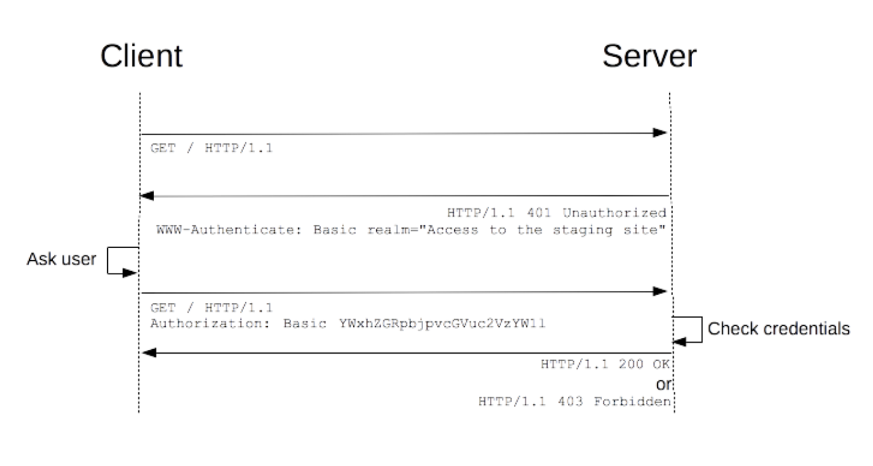
HTTP Authentication

Slide 141
HTTP Authentication
In the case of a "Basic" authentication like shown in the figure, in order to be secure, the exchange must happen over an HTTPS (TLS) connection.
The challenge and response flow works like this:
The server responds to a client with a 401 (Unauthorized) response status and provides information on how to authorize with a WWW-Authenticate response header containing at least one challenge.
A client that wants to authenticate itself with the server can then do so by including an Authorization request header with the credentials.
Usually a client (browser) will present a password prompt to the user and will then issue the request including the correct Authorization header.

Slide 142
Glassfish HTTP vs HTTPS
HTTPS for Glassfish is set up on port 8181 by default
This won't work with modern browsers because a self-signed certificate is used
We will work on HTTP (port 8080), knowing that in a real-world situation, we need to arrange for a proper TLS/SSL certificate (which usually costs money)

Slide 143
JEE Security
Application Layer Security
Component containers
What about data traveling across network?
Transport Layer Security
TLS (was SSL)
TLS/SSL is necessary for security when using Basic Auth
Basic Auth does only base64 encoding of username/password (easily reversed)
We use Basic Auth without TLS/SSL in this course, but you would NEVER DO THAT IN PRODUCTION or with a publicly accessible system
https:// urls
Involves trusted Certificate Authorities
Not sufficient on its own – need Application Layer Security also
Message-Layer Security (not in this course)
SOAP related

Slide 144
Securing JEE Web Apps
The Java EE Security API specification is on the JCP Ballot as JSR 375, for inclusion in Java EE 8.
The reference implementation (RI) of JSR 375 is called Soteria.
Before discussing JSR 375, we read some background information (covered by previous JEE Specifications):
https://docs.oracle.com/javaee/7/tutorial/security-intro005.htm

Slide 145
JEE 8 Security API
What does it provide us?
@BasicAuthenticationMechanismDefinition
@FormAuthenticationMechanismDefinition
@CustomFormAuthenticationMechanismDefinition
HttpAuthenticationMechanism interface:
public AuthenticationStatus validateRequest(…)
@ServletSecurity
IdentityStore interface
@DatabaseIdentityStoreDefinition
@LdapIdentityStoreDefinition
SecurityContext interface

Slide 146
Login Security: users
Login security is based on Realms, Users, Groups, and Roles
Usernames identify users, and users are grouped together in groups
Often the user will pick their username, and we set their group programmatically (as “guest” or “regular” for example)
A Role is defined by specifying a set of users and groups (by default, each group is a role, which is the default role mapping)
Username/Password database
OLD WAY: We set up a Realm (jdbc) which involves specifying where the system can retrieve usernames, passwords, and groups
NEW WAY: (Soteria) We set up an IdentityStore (DatabaseIdentityStoreDefinition) for usernames, passwords, groups
At runtime, when a user browses to a path covered by a security constraint, the system (with Basic and Form) will check username, password, and group/role

Slide 147
Login Security: resources
Resources are protected by requiring the user to be in a certain role
JSF Pages: We set security constraints (in web.xml) on URL path patterns (for example, we might specify user must be in Role “admin” to access URLS with path ”/admin/*”
RESTful API Resources: We require Roles by annotating the classes and methods corresponding to @PATH resources

Slide 148
Realms
A realm is a complete database of users and groups identified as valid users of one or more applications and controlled by the same authentication policy.
The Java EE server authentication service can govern users in multiple realms.

Slide 149
Realms cont'd
file Realm: user credentials are stored locally in a keyfile
file realm has users added using Glassfish Admin Console
See glassfish->Configurations->Security->Realms->file
certificate Realm: server stores user credentials in a certificate database
X.509 certificates
admin-realm Realm
Also a file realm, for administrators of the Glassfish server
jdbc Realm (old way): usernames, passwords, groups stored in a database accessed with JDBC
Enables us to add users programmatically at runtime
NEW WAY @DatabaseIdentityStoreDefinition
Enables us to add users programatically at runtime

Slide 150
Groups
Can be used to group users that have traits in common
Cannot be used in Certificate Realm
A group is designated for the whole Glassfish Server

Slide 151
Roles
A Role entails permission to access a set of resources
Users and groups are mapped to roles (giving those users permissions)
Done in glassfish-web.xml (example below)
The default Role mapping is Groupname = Rolename
In this course, we’ll use the default mapping
Example from a glassfish-web.xml:
<glassfish-web-app> ...
<security-role-mapping>
<role-name>Mascot</role-name>
<principal-name>Duke</principal-name>
</security-role-mapping>
<security-role-mapping>
<role-name>Admin</role-name>
<group-name>Director</group-name>
</security-role-mapping> ...
</glassfish-web-app>

Slide 152
Basic and Form Authentication
In web.xml, we can specify that Basic or Form Authentication should be used
Basic: browser’s built-in username/password dialog is used
Form: programmer specifies to use a specific login page and error page
Example html code for a login page:
<form action="j_security_check" method="post">
<input name="j_username" type="text"/>
<input name="j_password" type="password"/>
<input type="submit" />
</form>

Slide 153
Steps to secure logins to our apps
Specify which paths of the webapp are protected, and by which realm
For JSF pages, we do this in web.xml based on URL patterns
For RESTful API, we annotate EntityFacadeREST.java
Static Users: Use File Realm by adding Glassfish users manually at the Glassfish Admin Console->Configurations->Server Config->Security->Realms->File->Manage Users
Dynamic Users (what source code file can we put this in?):
@DatabaseIdentityStoreDefinition(
dataSourceLookup = "${'java:comp/DefaultDataSource'}",
callerQuery = "#{'select password from app.contact where userId = ?'}",
groupsQuery = "select groupname from app.contact where userId = ?",
hashAlgorithm = PasswordHash.class,
priority = 10
)

Slide 154
Steps to secure logins (cont’d)
For JSF (put annotations in a Java file in our project, we’ll use ApplicatonConfig.java):
@BasicAuthenticationMechanismDefinition
Or (in the following, substitute the real location and name of the forms)
@FormAuthenticationMechanismDefinition(
loginToContinue = @LoginToContinue(
loginPage = "/index.xhtml",
errorPage = "/index.xhtml"))
For RESTful API (in EntityFacadeREST.java):
@DeclareRoles
@RolesAllowed

Slide 155
Working with DataSources
As long as you have completed and you understand all of Lab 2, for work in this course after Lab 2, you may use the database of your choice
java:comp/DefaultDataSource
Uses Derby Database sun-appserv-samples
Username: app
Password: app
The username and password for sun-appserv-samples are in c:/glassfish5/glassfish/domains/config/domain1.xml
In Lab2, we created a new DataSource for a non-Derby database of your choosing, using a Netbeans Wizard. Alternatively, we could create a new DataSource using code in web.xml

Slide 156
Classnames for MySQL versions
When defining a datasource, be sure to use the right Driver classname, and DataSource classname for Derby (if you are using Derby) or for MySQL (if you are using MySQL/MariaDB)
MySQL/MariaDB Driver: com.mysql.cj.jdbc.Driver
MySQL/MariaDB Datasource: com.mysql.cj.jdbc.MysqlDataSource

Slide 157
Define Datasource Derby (web.xml)
<data-source>
<description>Todd's Tutoring data source.</description>
<name>java:global/TgkDataSource</name>
<class-name>org.apache.derby.jdbc.ClientDataSource</class-name>
<server-name>localhost</server-name>
<port-number>1527</port-number>
<database-name>sun-appserv-samples</database-name>
<user>app</user>
<password>app</password>
<property>
<name>connectionAttributes</name>
<value>;create=true</value>
</property>
</data-source>

Slide 158
Define DataSource MySQL/MariaDB (web.xml)
<data-source>
<description>Todd’s MySQL8 data source.</description>
<name>java:global/MySQLDataSource</name>
<class-name> com.mysql.cj.jdbc.MysqlDataSource</class-name>
<server-name>192.168.124.134</server-name>
<port-number>3306</port-number>
<database-name>myusers</database-name>
<user>tgk</user>
<password>tgkpass</password>
<property>
<name>connectionAttributes</name>
<value>;create=true</value>
</property>
</data-source>

Slide 159
DataSource Annotation
Alternatively to web.xml, we can use the @DataSource annotation in a Java file to define the datasource (property useSSL=false for MySQL8):
@DataSourceDefinition(
name = "java:global/ExampleDS",
className = "org.apache.derby.jdbc.ClientDataSource",
portNumber = 1527,
serverName = "localhost",
databaseName = "exampleDB",
user = "examples",
password = "examples",
properties={"create=true"})

Slide 160
JSF Pages: Add Constraint to paths
Edit web.xml and select security tab; or put the following in web.xml
<security-constraint>
<display-name>AdminConstraint</display-name>
<web-resource-collection>
<web-resource-name>moviedbadmin</web-resource-name>
<description>Administration area</description>
<url-pattern>/test/*</url-pattern>
</web-resource-collection>
<auth-constraint>
<description>Basic Constraint</description>
<role-name>Administrator</role-name>
</auth-constraint>
</security-constraint>

Slide 161
RESTful API resources constraints
In EntityFacadeREST.java, use
@DeclareRoles({"Admin","Regular"})
On the root resource to declare the roles that apply
@RolesAllowed(“Admin”)
On the method for the path to be protected

Slide 162
Turn on Protection for Faces Pages
Arrange for users to exist, with userid, password, group
File realm in glassfish: users added manually
Database table: users can be added dynamically
Turn on Authentication with an annotation in a Java file (often a servlet file, but for our purposes we’ll use ApplicationConfig as a convenient class name):
@BasicAuthenticationMechanismDefinition
@ApplicationScoped
@Named
public class ApplicationConfig { }
Specify which resources are protected, and which roles are allowed to access those resources (in web.xml)

Slide 163
Turn on protection for RESTful API resources
Arrange for users to exist, with userid, password, group
File realm in glassfish: users added manually
Database table: users can be added dynamically
Turn on Authentication with an annotation in ApplicationConfig.java extending Application
@BasicAuthenticationMechanismDefinition
@ApplicationScoped
@Named
public class ApplicationConfig extends Application{… }
Specify which resources are protected, and which roles are allowed to access those resources (@DeclareRoles, @RolesAllowed in EntityFacadeRest.java)

Slide 164
Turn on authentication in one file
For RESTful API we use the authentication annotation in ApplicationConfig.Java:
public class ApplicationConfig extends Application {
For JSF Pages, use use the authentication annotation in a servlet source file, OR an ApplicationConfig file
Turning on authentication for both at the same time
Use the RESTful API ApplicationConfig (which extends Application)
web.xml to define the security constraints for Java Server Faces
Annotations in EntityFacadeREST for RESTful resources

Slide 165
Declarative Security for address-book
Declarative: important programming paradigm where the programmer describes the solution, and “the system” figures out how to realize the solution
Solution in our case is that the system will block users from a set of URLs in our app unless they are authenticated to have an adequate role
declare JUST these things to add authentication to address-book:
What URLS of the app are protected, what Roles are required for those URLS (that’s it! – no implementation). Security Constraint
Where are passwords stored (DatabaseIdentityStore or file realm)
Where are usernames stored (DatabaseIdentityStore or file realm)
Where are groupnames stored (DatabaseIdentityStore or file realm)

Slide 166
Basic Auth Address-book
Basic Authentication for address-book application using file realm
Turn on authentication
OLD way (in web.xml)
<login-config>
<auth-method>BASIC</auth-method>
</login-config>
NEW way (annotation in a Java file, like ApplicationConfig.java)
@BasicAuthenticationMechanismDefinition

Slide 167
Basic Auth Address-book (cont’d)
Specify Security Constraints in web.xml (NEW way is same as OLD way)
<security-constraint>
<display-name>Constraint2</display-name>
<web-resource-collection>
<web-resource-name>Administration Area</web-resource-name>
<description>Accessible to admin users only</description>
<url-pattern>/dev/*</url-pattern>
</web-resource-collection>
<auth-constraint>
<description>Admin Area</description>
<role-name>Devel</role-name>
<role-name>Admin</role-name>
</auth-constraint>
</security-constraint>

Slide 168
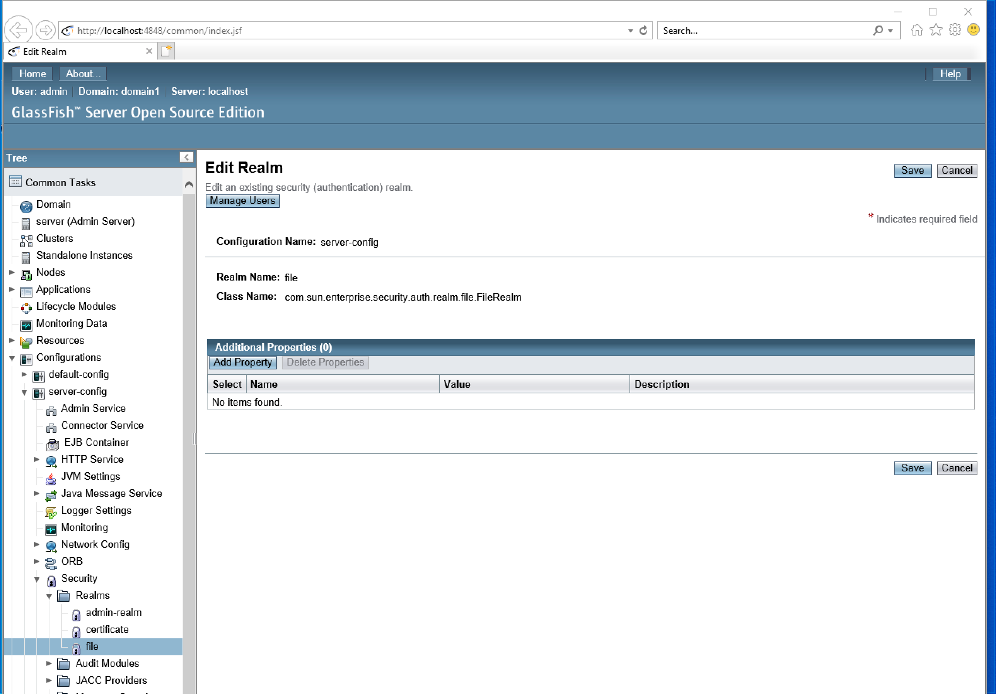
Basic Auth Address-book (cont’d)
Arrange for users to exist with usernames, passwords, and groups
One option is to use the file realm:

Slide 169
Basic Auth from database
Basic Authentication for address-book application using a database table
Use a @DatabaseIdentityStoreDefinition
@DatabaseIdentityStoreDefinition(
dataSourceLookup = "${'java:comp/DefaultDataSource'}",
callerQuery = "#{'select password from app.appuser where userid = ?'}",
groupsQuery = "select groupname from app.appuser where userid = ?",
hashAlgorithm = PasswordHash.class,
priority = 10
)
To use this @DatabaseIdentityStoreDefinition , we need a table called appuser with fields userid, password, groupname
We can make an application, similar to the address-book application, that manages appusers (this is Lab4)
Clone the address-book application and in the process, change the Entity to AppUser with those needed fields

Slide 170
Code to create a password hash
Notice that the Database Identity Store will use a PasswordHash class to compare the User’s password attempt to the stored password entry for that user
Here is code that will create password entries that can be checked with the default PasswordHash class
//set password entry
// initialize a PasswordHash object which will generate password hashes
Instance<? extends PasswordHash> instance = CDI.current().select(Pbkdf2PasswordHash.class);
PasswordHash passwordHash = instance.get();
passwordHash.initialize(new HashMap<String,String>()); // todo: are the defaults good enough?
// now we can generate a password entry for a given password
String passwordEntry = current.getPassword(); //the user has chosen a password
passwordEntry = passwordHash.generate(passwordEntry.toCharArray());

Slide 171
Password checking
User creates an account with a new password, the PasswordHash implementation will
generate a random salt value
Add the salt value to the password
Hash the salted password to get the hashed value
Store the password entry as algorithm:salt:hash
Later on…
User enters their claimed password to authenticate
Retrieve the algorithm:salt:hash for that user from the database
Add the salt to the claimed password
Hash the salted claimed password with the algorithm to get claimed_hash
Compare claimed_hash to hash and if they are the same, the claimed password is the same as the stored password

Slide 172
Password Checking
Account Creation
User Login
Admin enters
Cleartext password
User enters password candidate
Generate random
salt
Retrieve random salt
Add salt to password
Add salt to candidate
Apply Hash Algorithm
Apply Hash Algorithm
Store entry
Algorithm:salt:hash
Compare candidate hash to stored hash

Slide 173
Summary
To protect Faces pages
Annotations in some named application-scoped bean (the one used for RESTful API below, will work)
Turn on Authentication
Specify the DatabaseIdentityStoreDefinition
Security Constraints go in web.xml
Specify the resource as a URL pattern
Specify the roles allowed to access that resource
To protect RESTful API resources
Annotations in ApplicationConfig exends javax.ws.rs.core.Application
Turn on Authentication
Specify the DatabaseIdentityStoreDefinition
Security Constraints go in EntityFacadeRest.java
Specify @RolesAllowed(“…”) as an annotation on each resource

Slide 174
Summary again in table form
 | JSF Pages | RESTful API
Users, Groups | File realm or @DatabaseIdentityStoreDefinition | File realm or @DatabaseIdentityStoreDefinition
Role Mapping | Default Group->Role or web.xml (in this course we tend to use the default group->role mapping, so every group is a role) | Default Group->Role or web.xml (in this course we tend to use the default group->role mapping, so every group is a role)
Turn Authentication On | web.xml OR @BasicAuthenticationMechanismDefinition on a configuration class with @ApplicationScoped @Named (an application-scoped Named bean) OR @FormAuthenticationMechanismDefinition on a configuration class with @ApplicationScoped @Named (an application-scoped Named bean) | @BasicAuthenticationMechanismDefinition on an @ApplicationScoped configuration class in the app that extends javax.ws.rs.core.Application
Protect Resources | web.xml security constraint with a URL pattern | @DeclareRoles (at the top) @RolesAllowed on method In a class with a @PATH annotation For us, that is EntityFacadeREST.java (for example, SpriteFacadeREST.java)

Slide 175
Web Enterprise Application Programming
React Front End for the RESTful API

Slide 176
Lab 5
Lab 5 will be posted soon.
Lab 5: implement a React page to display the First and Last names of the list of Contacts
All of the information required to do Lab 5 is in this slide deck

Slide 177
CST8218 React Strategy
Follow in the footsteps of LuisPa -- https://dev.to/luispa/lets-try-react-without-nodejs-3a7
Create an html page that references the ReactJS and React-dom libraries from the internet
Also reference Babel https://babeljs.io which is a Javascript compiler that translates next-gen Javascript (JSX and React) into browser-compatible Javascript
Can then put React code/components on the page using
<script type="text/babel">
…react component here
</script>

Slide 178
ReactJS (based on https://reactjs.org/tutorial/tutorial.html)
Build User Interfaces for SPA with React Components
The type of React Component we will work with are subclasses of React.Component
class ShoppingList extends React.Component {
render() {
return (
<div className="shopping-list">
<h1>Shopping List for {this.props.name}</h1>
<ul>
<li>Instagram</li>
<li>WhatsApp</li>
<li>Oculus</li>
</ul>
</div>
);
}
} // Example usage: <ShoppingList name="Mark" />

Slide 179
JSX
The language inside the return()on the previous slide is a React element expressed in the language JSX
The JSX on previous slide is syntactic sugar for the following Javascript code
React.createElement("div", {className: "shopping-list"},
React.createElement("h1", null, "Shopping List for ", props.name),
React.createElement("ul", null,
React.createElement("li", null, "Instagram"),
React.createElement("li", null, "WhatsApp"),
React.createElement("li", null, "Oculus")
)
);
Notice the Javascript expression props.name was placed in braces as {this.props.name} when it appeared in JSX

Slide 180
React Component Properties
The attributes/properties of a Component are called props
On the previous slides we saw the name prop being used for the ShoppingList component:
Example usage: <ShoppingList name="Mark" />
Then inside the component the name prop was referenced as
Javascript expression in JSX:
{this.props.name}
Javascript expression:
props.name

Slide 181
React Component State
React components maintain state by initializing state variables in their constructor:
class ShoppingList extends React.Component {
constructor(props) {
super(props);
this.state = { value: null, };
}
…
}

Slide 182
React Component State Immutable
this.state should be considered immutable, such that you only make changes to this.state by using this.setState(newState)where newState is a changed copy of this.state (or completely new)

Slide 183
Calling a RESTful API
To call our RESTful API to get data, we will use the lifecycle method called componentDidMount()
getContacts(){
fetch("http://192.168.124.2:8080/mavenproject8/resources/com.mycompany.mavenproject8.contact",{
headers: {'Accept': 'application/json'}})
.then(res => res.json())
.then(resjson => this.setState({contacts: resjson}));
}
// componentDidMount() is called by the system
componentDidMount() {
this.getContacts();
}

Slide 184
Calling a RESTful API (cont'd)
When the component mounts, the system calls the React lifecycle method, componentDidMount(), which calls our function, getContacts(), which calls the Javascript function fetch()
fetch() returns a Javascript Promise
The Promise is the not-yet-resolved result of the fetch(), and the Promise has a then()method which takes a function that is applied to the result of the fetch() when it is resolved
The fetch() eventually returns a string representing the list of contacts in JSON format, at which time the function res => res.json() is applied to the string, parsing it into a Javascript list of contact objects, and returning that list as a chained Promise
When that second chained Promise is resolved, the function resjson => this.setState({contacts: resjson}) is applied to the list of contacts, which uses setState to set this.state.contacts to be that list of contacts

Slide 185
React page for Contacts (1of2)
<!DOCTYPE html>
<html lang="en">
<head>
<meta charset="UTF-8">
<meta name="viewport" content="width=device-width, initial-scale=1.0">
<meta http-equiv="X-UA-Compatible" content="ie=edge">
<title>Play with React</title>
<script type="application/javascript" src="https://unpkg.com/react@16.0.0/umd/react.production.min.js"></script>
<script type="application/javascript" src="https://unpkg.com/react-dom@16.0.0/umd/react-dom.production.min.js"></script>
<script type="application/javascript" src="https://unpkg.com/babel-standalone@6.26.0/babel.js"></script>
</head>
<body>
<div id="root"></div>
<script type="text/babel">
// Obtain the root
const rootElement = document.getElementById('root')
// Create a ES6 class component
class ContactList extends React.Component {
// Use the render function to return JSX component
constructor(props) {
super(props);
this.state = { count: "", contactsstring: "", contacts: [] };
}
callAPI() {
//insert code
}
componentDidMount() {
this.callAPI();
}

Slide 186
React page for Contacts (2of2)
render() {
const valuesArray = this.state.contacts;
return (
<div className="contact-list">
<h1>Contact List {this.props.name}</h1>
<ul>
<li>count: {this.state.count}</li>
<li>array size: {valuesArray.length} </li>
{valuesArray.map((item,key)=>{return <li key={key}>{item.firstname} {item.lastname} {item.homephone} </li>})}
</ul>
</div>
);
}
}
// Create a function to wrap up your component
function App(){
return(
<div>
<ContactList name="Using React!"/>
</div>
)
}
// Use the ReactDOM.render to show your component on the browser
ReactDOM.render(
<App />,
rootElement
)
</script>
</body>
</html>

Slide 187
Agenda
Software Testing
Testing JEE applications
Unit Testing
Integration Testing
User Interface Testing

Slide 188
Software Testing
Functional Testing
Unit testing
Integration testing
System Testing
User Acceptance testing
Non-Functional Testing
Security Testing
Performance Testing
Compatibility Testing
Usability testing
Compliance Testing

Slide 189
Testing Analysis
Code coverage
All lines of code tested
All error handling code for all error conditions
Boundary Conditions
Identify the equivalence classes of inputs
Identify the boundaries between classes of inputs
Problems with code often occur with input at the boundaries

Slide 190
JUnit 4 vs JUnit 5
JUnit 5 has been released: https://blogs.oracle.com/javamagazine/migrating-from-junit-4-to-junit-5-important-differences-and-benefits
JUnit 5 automatically used for Maven-based projects
JUnit 4 for Ant-based projects (Sprites):
Add junit 4.12 to project's libraries
Add hamcrest 1.3 to project's libraries
Proceed as in demonstration video

Slide 191
JUnit for Sprite projects
JUnit 4 for Ant-based projects (Sprites-war and Sprites-ejb):
Add junit 4.12 to project's libraries
Add hamcrest 1.3 to project's libraries
After adding these libraries to the project, you can then create and run Junit Version 4 tests and test suites, as shown in JUnitDemo.mp4 video

Slide 192
Unit Testing
Test small pieces in isolation
Method, class, or function level
Unit tests can be performed manually
Unit tests often lend themselves to automation
JUnit is an automated unit testing framework for Java

Slide 193
JUnit features
JUnit Classes
Fixtures
Test Suites
Test Runners

Slide 194
JUnit classes
A JUnit class is dedicated to a set of tests
The framework provides mechanisms for methods that will run automatically:
@beforeClass
@afterClass
@before
@after
This annotations are used to designate the methods that should auto-run

Slide 195
JUnit Fixtures
A fixture is a fixed state of a set of objects forming an environment for repeatable tests
setUp() method, which runs before every test invocation: use @Before
tearDown() method, which runs after every test method: use @After

Slide 196
JUnit tests
Use the @Test annotation to indicate which methods should run as tests
@Test
public void testIt(){
private String message =“hello”;
//do something
assertEquals(message,”tester”);
}

Slide 197
Assert methods
Tests pass or fail based on assertions:
1 | void assertEquals(boolean expected, boolean actual) Checks that two primitives/objects are equal.
2 | void assertFalse(boolean condition) Checks that a condition is false.
3 | void assertNotNull(Object object) Checks that an object isn't null.
4 | void assertNull(Object object) Checks that an object is null.
5 | void assertTrue(boolean condition) Checks that a condition is true.
6 | void fail() Fails a test with no message.

Slide 198
Test Runner (default)
import org.junit.runner.JUnitCore;
import org.junit.runner.Result;
import org.junit.runner.notification.Failure;
public class UseDefaultTestRunner {
public static void main(String[] args) {
Result result = JUnitCore.runClasses(TestJunit.class);
for (Failure failure : result.getFailures())
System.out.println(failure.toString());
}
System.out.println(result.wasSuccessful());
}
}

Slide 199
Test Runner (custom)
@RunWith(CustomTestRunner.class)
public class ATestClass { ….. }
Public class CustomTestRunner extends BlockJUnit4ClassRunner {….}

Slide 200
Test Suites (a built-in runner)
Runs a group of test classes together:
import org.junit.runner.RunWith;
import org.junit.runners.Suite;
//JUnit Suite Test
@RunWith(Suite.class)
@Suite.SuiteClasses({
TestJunit1.class,TestJunit2.class
})
public class JunitTestSuite { }

Slide 201
Mocking Frameworks
Mocking is the process of emulating components and services for the purposes of (unit) testing
Example of mocking framework: Mockito
Maven dependency on mockito-core

Slide 202
Mockito example
import static org.mockito.Mockito.*;
// mock creation
List mockedList = mock(List.class);
// using mock object - it does not throw any "unexpected interaction" exception mockedList.add("one");
mockedList.clear();
// selective, explicit, highly readable verification verify(mockedList).add("one"); verify(mockedList).clear();

Slide 203
Mockito example
// you can mock concrete classes, not only interfaces LinkedList mockedList = mock(LinkedList.class);
// stubbing appears before the actual execution when(mockedList.get(0)).thenReturn("first");
// the following prints "first" System.out.println(mockedList.get(0));
// the following prints "null" because get(999) was not stubbed
System.out.println(mockedList.get(999));

Slide 204
Mockito documentation
http://static.javadoc.io/org.mockito/mockito-core/2.23.4/org/mockito/Mockito.html

Slide 205
UI Testing frameworks
Selenium
Screenster
TestCraft
Endtest
Browsersync
Protractor
CasperJS
Ghost Inspector
Cypress.io

Slide 206
Selenium
Selenium IDE is a Chrome or Firefox addon
Can create web-based application tests
Will record your interactions to facilitate testing
Add verifications and asserts to tests
See also https://www.seleniumhq.org/docs/02_selenium_ide.jsp

Slide 207
Agenda
(Announce) Extra Sessions due to Good Friday holiday
Assignment 1 Solutions
Session Beans
Can we unit test session beans?
Final Exam
Tuesday April 19, 2-4pm
React for Sprites

Slide 208
Addressbook application
Glassfish
Named Bean
ContactController
EJB
ContactFacade
Contact.class
Browser
Web Pages
JSF
*.xhtml
Database

Slide 209
Cloned-Addressbook RESTful API
Glassfish
Postman
JAX-RS
EJB
ContactFacadeREST
Contact.class
Database

Slide 210
Cloned-Addressbook RESTful API
Glassfish
Postman
JAX-RS
EJB
ContactFacadeREST
Java Client
XML
JSON
Contact.class
Database

Slide 211
Cloned-Addressbook RESTful API
Postman
Glassfish
Java Client
XML or JSON
JAX-RS
EJB
ContactFacadeREST
Mobile App
XML or JSON
Browser App
Contact.class
ReactJS JSON
Business
B2B
XML or JSON
Database

Slide 212
Clients do not access DB directly
Cloud Firestore Database Service
Client
Process
Fine
Database
Client
Process
No!
Database

Slide 213
Assignment 1 Diagram (enhanced)
Postman
Glassfish
Java Client
XML or JSON
JAX-RS
EJB
SpriteFacadeREST
Mobile App
XML or JSON
Browser App
XML or JSON
Sprite.class
EJB
SpriteGame
EJB
GameSession
Business
B2B
XML or JSON
Named
SpriteController
EJB
SpriteFacade
Database
Browser App
JSF Pages

Slide 214
Addressbook application
Glassfish
Named Bean
ContactController
EJB
ContactFacade
Contact.class
Browser
Web Pages
JSF
*.xhtml
Database

Slide 215
Enterprise Web Applications (in a nutshell)
Server-side Java: Jakarta EE
Java EE technologies have moved to the Eclipse Foundation: Glassfish 5.1
Netbeans IDE
Netbeans has traditionally had good integration with Glassfish
Eclipse has modules to offer good integration too
Three Tiered Architecture (address-book)
Presentation tier (JSF pages with their Named bean controller)
Business tier (Enterprise Java Beans, business rules, façade for Data Layer)
Data tier (Derby, MariaDB, MySQL, etc)
Persistence
Object Relational Mapping
Persistence Unit: Entities (java objects) stored in database
EntityFacade @PersistenceContext connects EntityManager to persistence unit
persistence.xml: specifies the persistence unit:
the set of Entities
the database
RESTful HTTP interface (REST API)
Can be used for
Mobile App backend server
M2M (Machine to Machine)
Authentication/Authorization
Declarative security
Testing with jUnit, SeleniumIDE

Slide 216
Java / Jakarta EE
EE4J platform (until now) developed through the Java Community Process (the JCP), which is responsible for all Java technologies
XML deployment descriptors are used less, in favor of annotations
Developers enter the information as an annotation directly into a Java source file, and the Java/Jakarta EE server will configure the component at deployment and runtime
Dependency injection can be used in EJB containers, web containers, and application clients.
Dependency injection allows the Java EE container to automatically insert references to other required components or resources, using annotations.

Slide 217
Tiered Architecture / Separation of Concerns
Enterprise applications are inherently complex
Presentation: accessing data from a variety of sources and distributing applications to a variety of clients
Presentation layer (browser or Mobile App)
Business: To better control and manage these applications, the business functions to support these various users are conducted in the middle tier
The middle tier represents an environment that is closely controlled by an enterprise’s information technology department.
Data: flexible use of storage – different databases, EIS

Slide 218
Web Applications
Here's a point that some students seem to forget when they take this course. REMEMBER:
We do not need Netbeans to launch a web browser for us
We are capable of launching a web browser without having Netbeans do if for us
After a web application is deployed, we can repeatedly browse to it's URL (along with many other users)

Slide 219
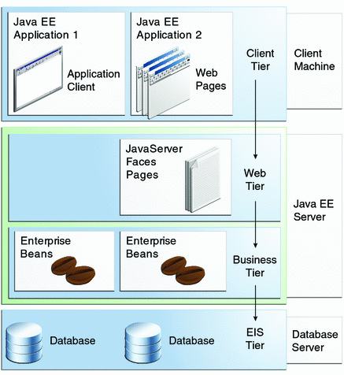
Multitiered Applications

Slide 220
Addressbook application
Glassfish
Named Bean
ContactController
EJB
ContactFacade
Contact.class
Browser
Web Pages
JSF
*.xhtml
Database

Slide 221
Cloned-Addressbook with RESTful API
Postman
Glassfish
Java Client
XML or JSON
JAX-RS
EJB
ContactFacadeREST
ContactFacade
Mobile App
XML or JSON
Browser App
XML or JSON
Contact.class
Business
B2B
XML or JSON
Browser App
JSF Pages
Database

Slide 222
Final Exam application
Glassfish
Postman
JAX-RS
EJB
EntityFacadeREST
Named Bean
EntityController
Entity.class
Browser
EJB
EntityFacade
Database
Web Pages
JSF
*.xhtml

Slide 223
Security
Java EE security environment enables security constraints to be defined at deployment time
Java EE platform makes applications portable to a wide variety of security implementations by shielding application developers from the complexity of implementing security features
Examples
Basic auth, and other mechanisms
Hashing implementation
provides standard declarative access control rules that are defined by the developer and interpreted when the application is deployed on the server
same application works in a variety of security environments without changing the source code

Slide 224
Java / Jakarta EE Containers
thin-client multitiered applications are hard to write:
Transaction and state management
Multithreading
Resource pooling
Complex low-level details…
the Java / Jakarta EE server provides underlying services in the form of a container for every component type
Containers form the interface between the component and the low-level platform specific functionality
Each web, enterprise bean, or application client component must be assembled into a Java / Jakarta EE module and deployed in its container

Slide 225
Enterprise JavaBeans
Enterprise Bean is a body of code having fields and methods to implement modules of business logic
Two types
Session Bean: usually represents a transient conversation with a client. When the client finishes executing, the session bean and its data are gone.
@Stateless
@Stateful
Message-driven Bean: combines features of a session bean and a message listener, allowing a business component to receive messages asynchronously. Commonly, these are Java Message Service (JMS) messages.

Slide 226
JavaServer Faces Technology
A user interface framework for building web applications
Main Components:
A GUI component framework
A flexible model for rendering components in different kinds of HTML or different markup languages and technologies. A Renderer object generates the markup to render the component, and converts the data stored in a model object to types that can be represented in a view
Features supporting GUI components:
Input validation
Event Handling
Data conversion between model objects and GUI components
Page navigation configuration
Expression Language (EL)
Internationalization

Slide 227
Java Persistence API (JPA)
The Java Persistence API is a Java standards-based solution for persistence.
EclipseLink implements the JPA (the default implementation when you install JEE). (Hibernate also implements JPA)
Persistence uses an object/relational mapping approach to bridge the gap between an object-oriented model and a relational database.
The Java Persistence API can also be used in Java SE applications, outside of the Java EE environment
Swing/Hibernate
Java Persistence consists of the following areas:
The Java Persistence API
The query language
Object/relational mapping metadata

Slide 228
Java API for RESTful Web Services
Representational State Transfer (REST) architectural style
The JAX-RS API was introduced in Java EE 6 (now at JEE 8)

Slide 229
Named Beans
lightweight container-managed objects (POJOs)
The @Named (javax.inject.Named) annotation in a class, along with a scope annotation, automatically registers that class as a resource with the JavaServer Faces implementation
Example ShoppingCart class:
@Named("cart")
@SessionScoped
public class ShoppingCart ... { ... }

Slide 230
Named bean scopes
Application (javax.enterprise.context.ApplicationScoped): Application scope persists across all users' interactions with a web application.
Session (javax.enterprise.context.SessionScoped): Session scope persists across multiple HTTP requests in a web application.
Request (javax.enterprise.context.RequestScoped): Request scope persists during a single HTTP request in a web application.

Slide 231
Addressbook application
Glassfish
Named Bean
(ContactController)
EJB
(ContactFacade)
EL
Contact.class
Browser
Web Pages
Database

Slide 232
AddressBook (programmer's view)
Entity Class: Contact.java
contains annotations for ORM
Contact table created in Derby database engine or other database engine
Stateless Session Bean: ContactFacade.java
database session, not user's session
interacts with and queries the database with EntityManager
Named Bean: ContactController.java
session scoped (the user's session)
connects the presentation page components (JSF) with the EJB
Obtains an instance of ContactFacade through dependency injection
@Inject private ContactFacade ejbFacade;
Example: prepareEdit and edit methods
when the user clicks the "Edit" button, it calls the prepareEdit function, which gets the data through the ContactFacade and forwards to the Edit view, a JSF page
user enters data and clicks Submit, EL calls the update method, saving updated data through the ContactFacade

Slide 233
AddressBook (programmer's view) Cont'd
JSF presentation layer: xhtml pages that contain Expression Language expressions used to communicate with the Named bean
Expression Language
#{bean.method}
EL example:
#{customer.name}
When reading, this would be the result of the getName method of the named bean called "customer"
When writing, this would call setName method of the bean called "customer"
https://docs.oracle.com/javaee/7/tutorial/jsf-el.htm#GJDDD
Uses JSF tag libraries:
xmlns:h="http://xmlns.jcp.org/jsf/html"
xmlns:f="http://xmlns.jcp.org/jsf/core">

Slide 234
What's this EntityFacade?
The ContactFacade is the DAO (Data Access Object) for the Contact Entity (a Contact is a persistent object)
A DAO is the go-to object for doing CRUD operations on an Entity
Create
Read
Update
Delete
Sessions and Transactions of the EntityManager in the ContactFacade are handled for us by the JTA (see persistence.xml):
<persistence-unit name="address-bookPU" transaction-type="JTA">
<jta-data-source>MySQLDB</jta-data-source>

Slide 235
Testing
Testing is not the only way to assure code quality
Informal or formal code inspections
Source Code Control
Formal testing (tests that are written down) is important
Automated tests are written down as source code
Automated tests are inexpensive to re-run for regression testing, etc
Manual tests are written down (for example, in a spreadsheet)
Test setup, instructions, expected result, how to evaluate if test passed
Formal testing can be analyzed
For completeness of tests
For efficacy of tests
To help guide regression testing after changes
Informal testing (not written down)
No good way to analyze it for completeness or desired characteristics
No good way to re-test (regression etc)

Slide 236
Final Exam Programming Question
The final exam question will have the main "first bullet", which requires Entity, JSF Pages, and RESTful API
The subsequent bullets will require something added to that base:
You will be asked to put either your student number or Algonquin ID at the top of various files
Example "put your student # in a comment near the top of an Enterprise Java Bean"
Example "put your Algonquin userid in a comment near the top of two JSF pages"
Possible example: put validation on one of the fields
Possible example: make one of the REST API methods do something different from the default
Possible example: localize some strings on one of the JSF pages
Possible example: secure part of the RESTful api (Authorization)

